Slide 1
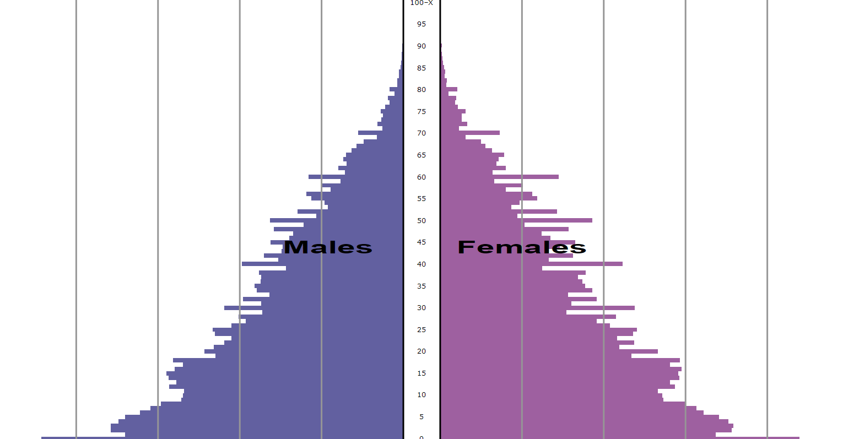
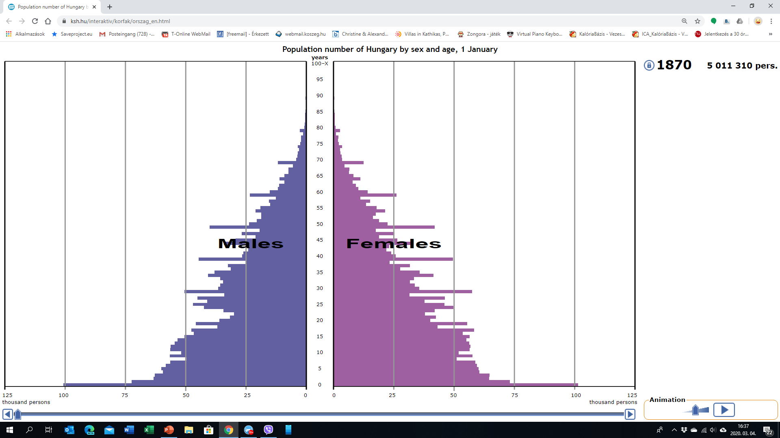
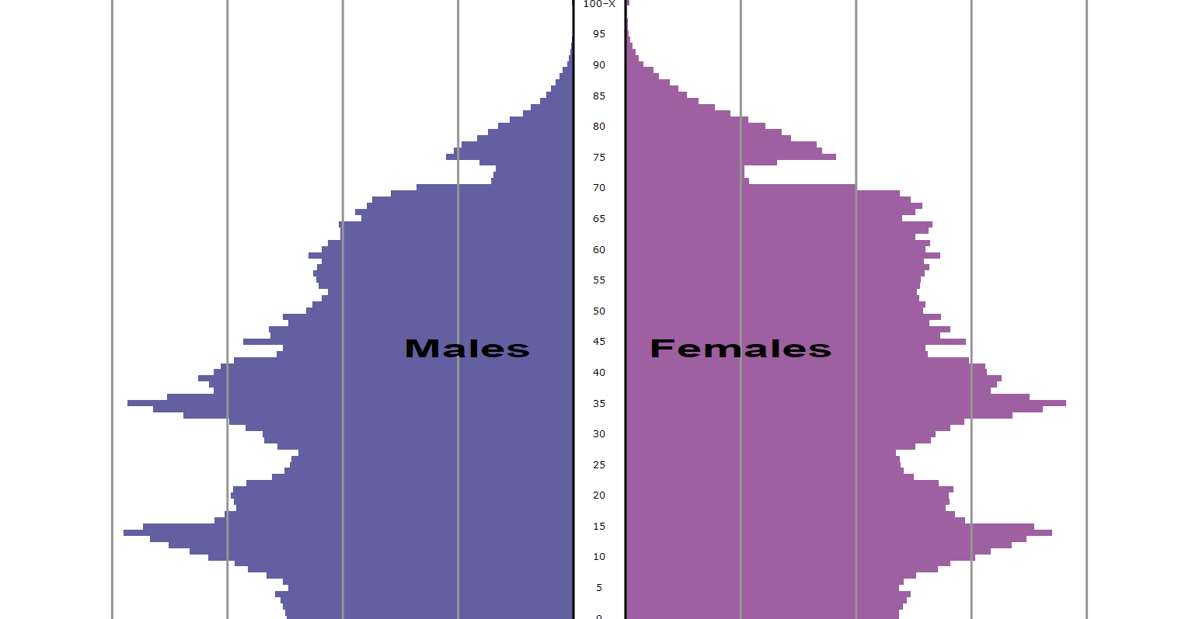
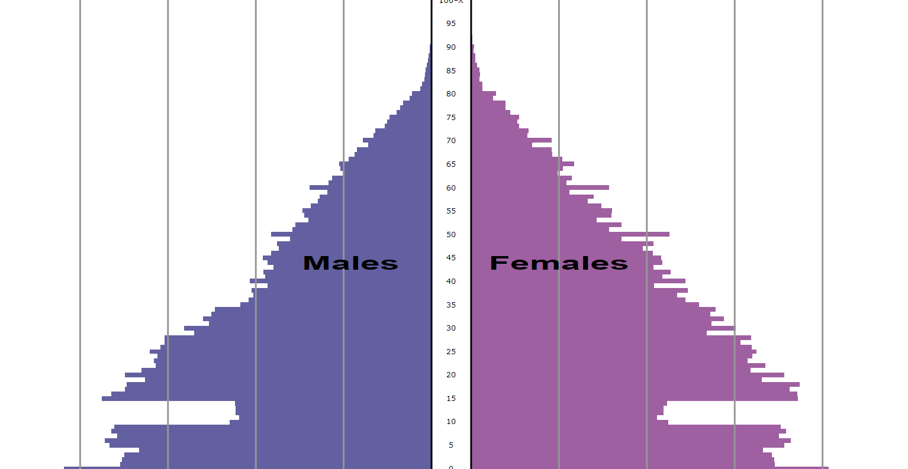
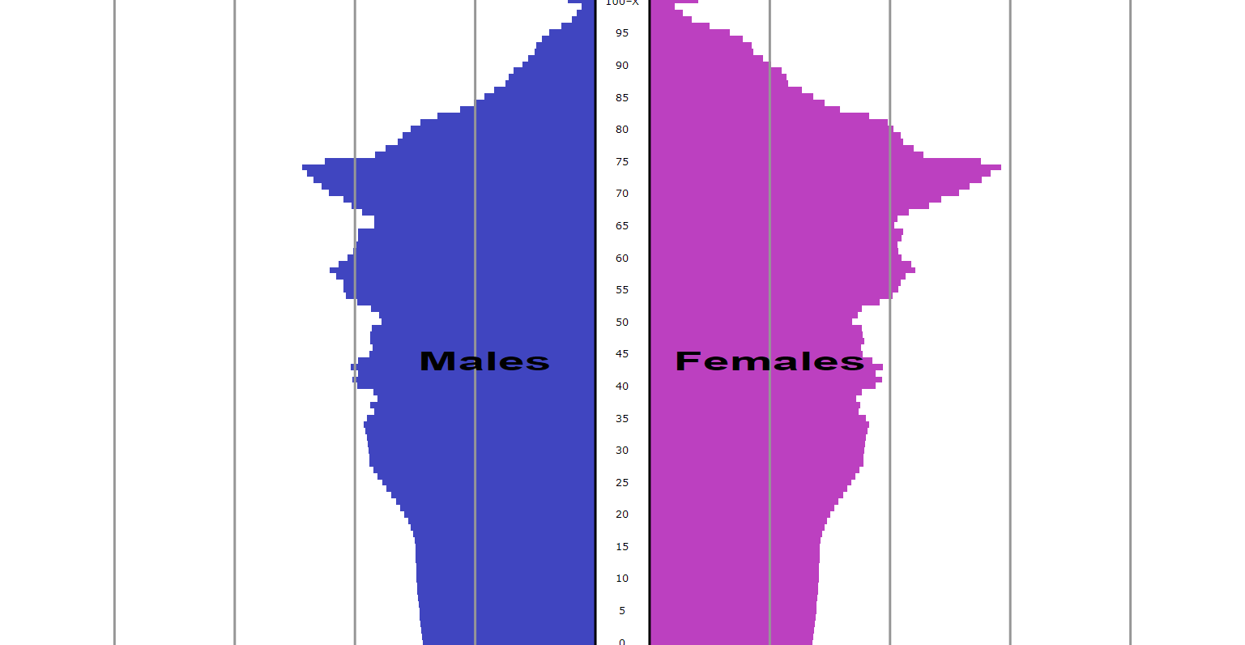
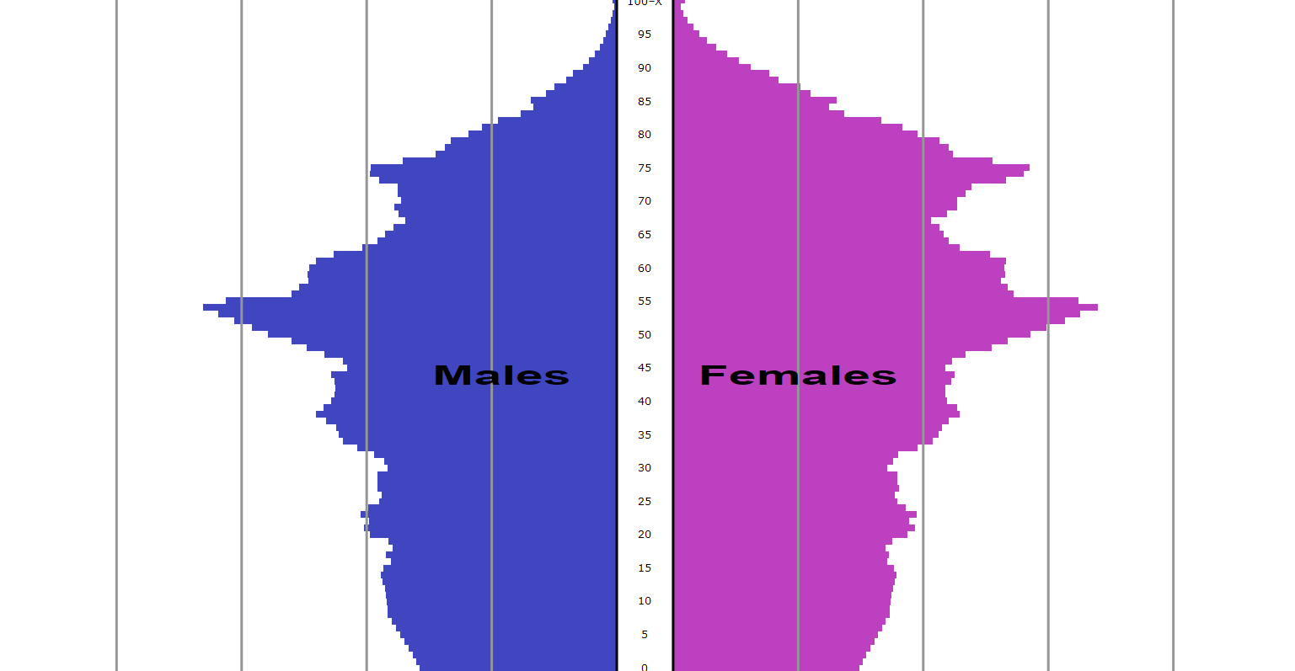
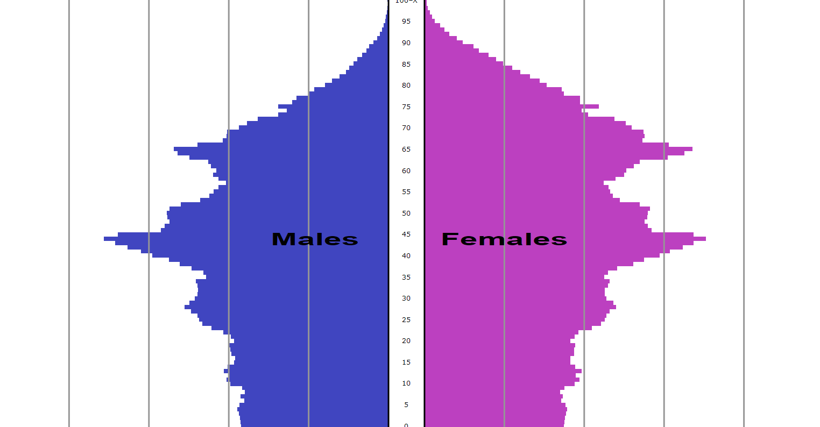
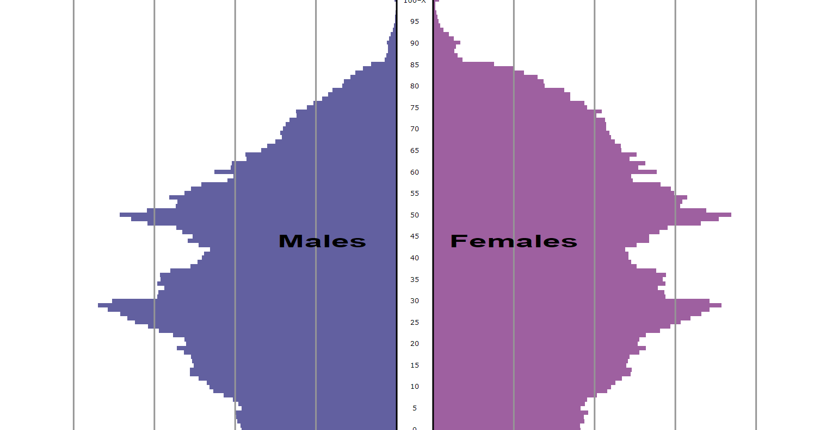
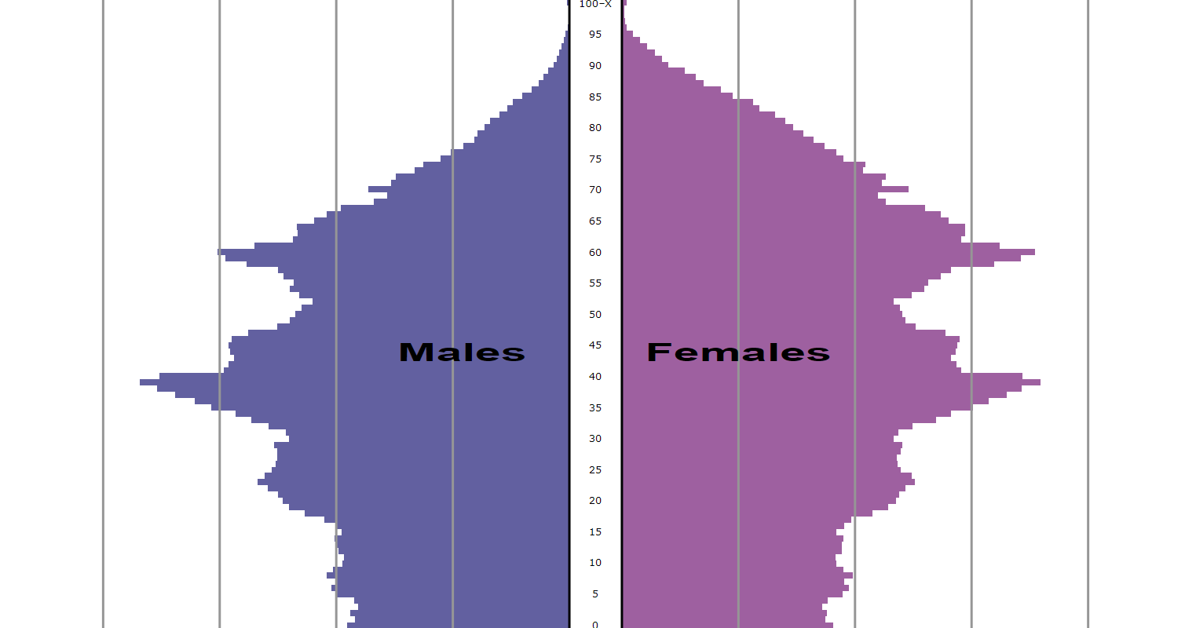
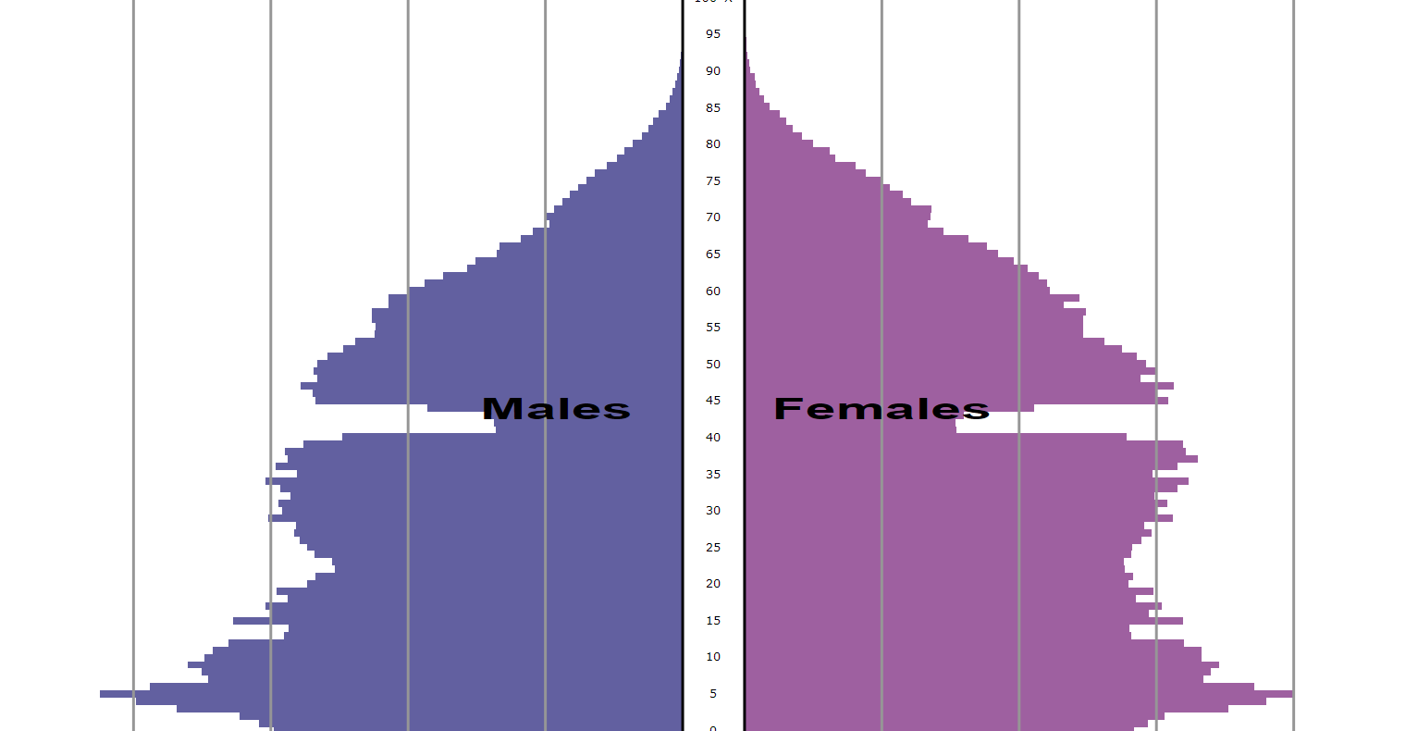
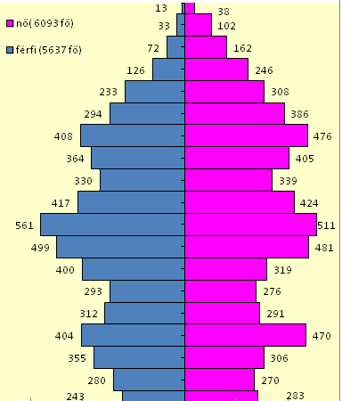
Europe for Citizens - Network of Towns - ACTAGE - event #2, Škofja Loka
Population pyramid of Hungary
1870
2015
1900
2020
1930
2030
1960
2060
1990
2005
Kőszeg - Youngsters

Slide 2
Europe for Citizens - Network of Towns - ACTAGE - event #2, Škofja Loka
Key challenges
Financial problems
Health problems
Social isolation
Aging related cognitive impairments, disabilities
Health care problems
Everyday life
Living alone
Loss of spouse or friends
Transport issues
COVID!!!
Housing
Free time activities
Retirement
Holiday
Kőszeg - Youngsters

Slide 3
Europe for Citizens - Network of Towns - ACTAGE - event #2, Škofja Loka
Good practice
CSOK: Family Home Allowance
Organizing Performances (by schools)
Compulsory 50-hours-charity service for secondary school students
Contract of lifetime care for the property;
Voluntary charity work
(E.g. teaching IT)
Grandparents – grandchildren excursions
Kőszeg - Youngsters

