Slide 1
Juniors and Seniors – Active aging
2020, Škofja Loka-Rokiškis

Slide 2
The aging situation in Rokiškis, Lithuania
Lithuanian population - 2 794 329
Rokiškis municipality population – 28 070
Population by age (% of total Rokiskis municipality)
Years/Age | Up to 14 | 15-64 years old | 65 and older
2015 | 12,1 | 64,9 | 23,0
2016 | 12,1 | 64,7 | 23,2
2017 | 12,1 | 64,3 | 23,6
2018 | 12,2 | 63,7 | 24,1
2019 | 12,1 | 63,4 | 24,5
More than twice, 65 and older inhabits population consist of female
Source: Official Statistics Portal. City data. https://osp.stat.gov.lt/infografikas102, accessed 09 March 2020

Slide 3
Key challenges we face
Generational Differences (Generation gap): rare oportunities for joint activities; misunderstandings about the programme of public events;
Technological influences: some information available either via newspapers (paid subscription) or on the internet; subsistence money via bank card; cash withdrawal at the machine; phones require certain account (gmail or other); PIN driven phone disturb during events with notifications and sounds during (seniors fear to silence or switch a phone off);
Workplace attitudes: IT challenges (most technologies managed via phone), tools programming.

Slide 4
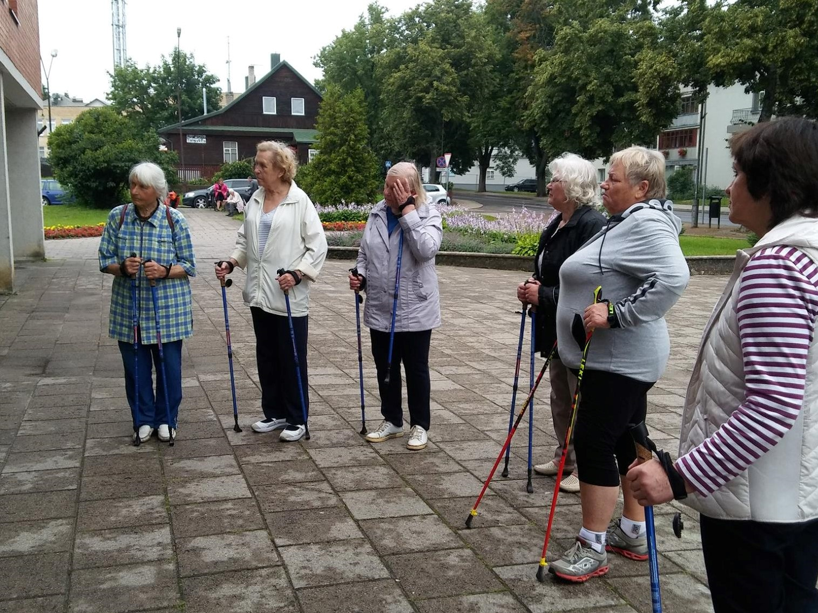
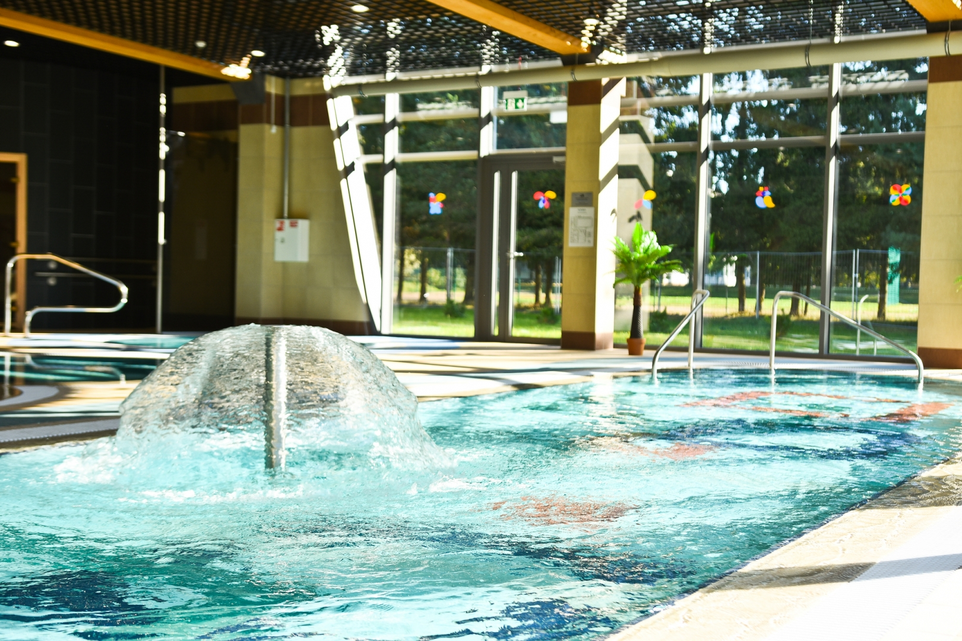
Recent Infrastructure Projects
Seniors learn Nordic Walking.
Active in the Pool.

Slide 5
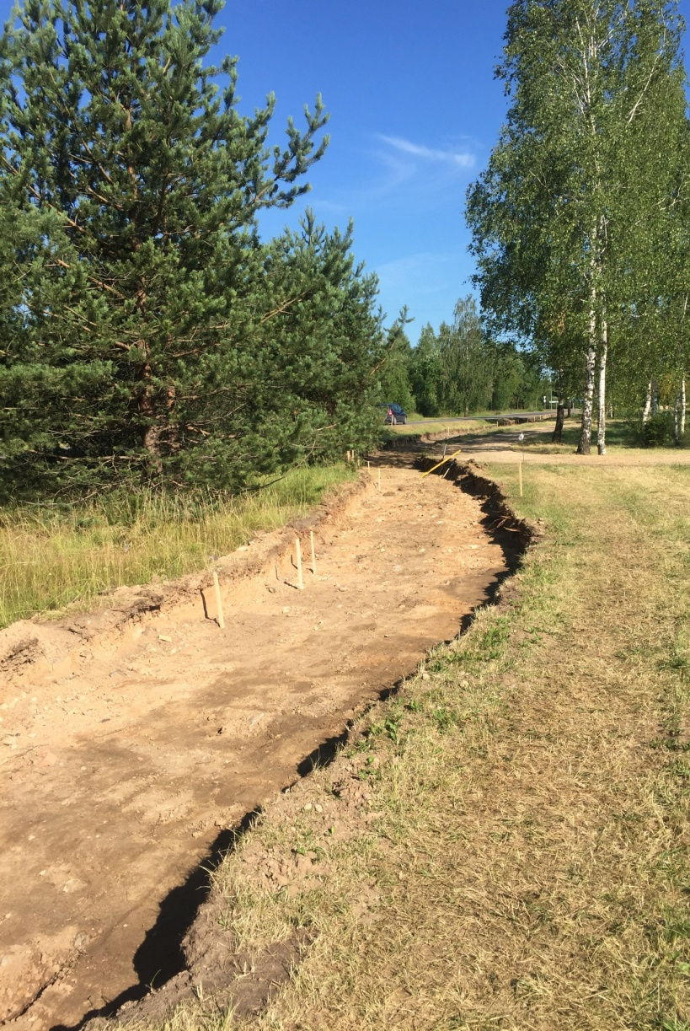
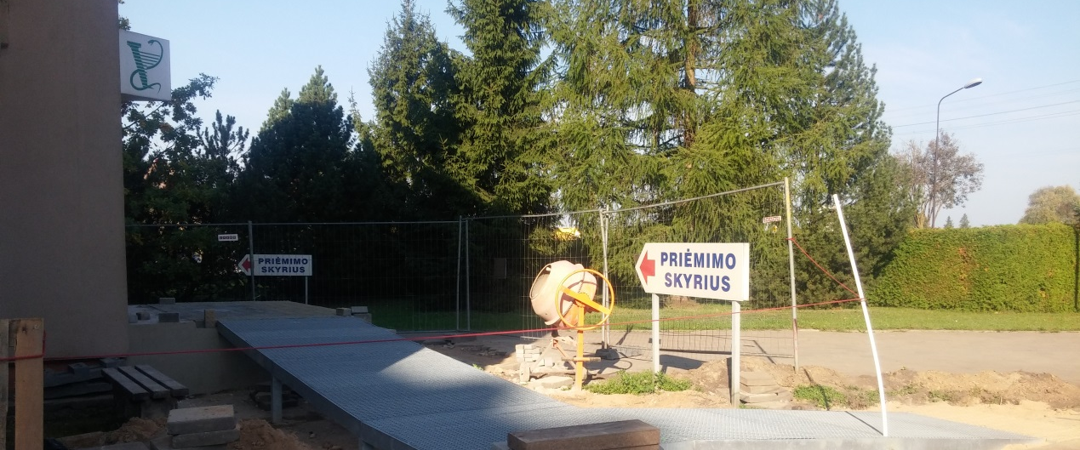
Pedestrian and cycling paths.
Hospital accessibility pad.

Slide 6
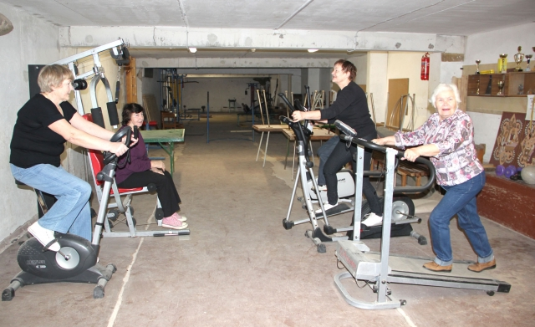
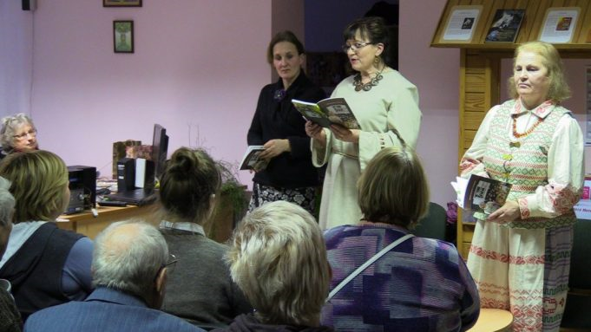
Non-governmental organisations for seniors
Writers‘ and Poetss Club „Rainbow”
Church community club „Caritas“
Community of disabled people
Club „Artritis“

Slide 7
Events for all age groups
State days
City birthday
Easter, Christmas, Mother‘s Day, Father‘s Day
Outdoor summer festival „Vasaronės“

Slide 10
Services of the Rokiškis Social Care Center

Slide 11
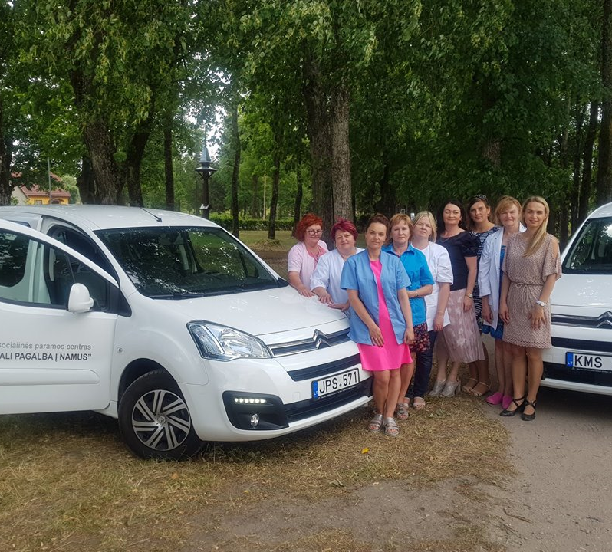
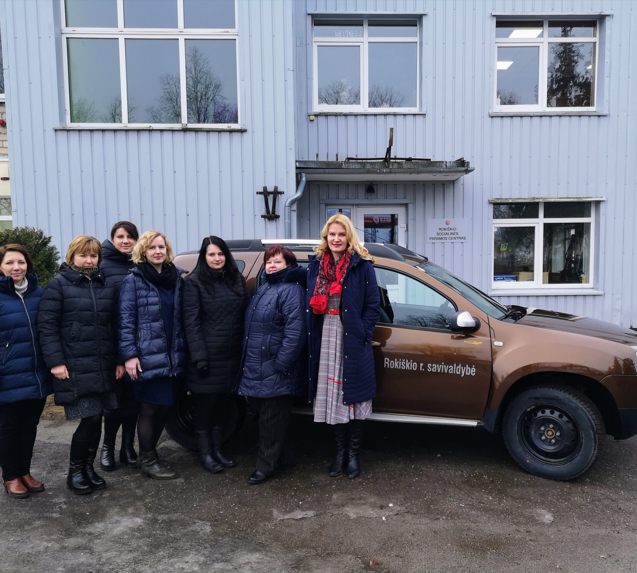
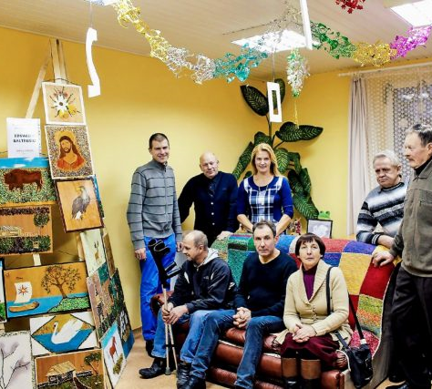
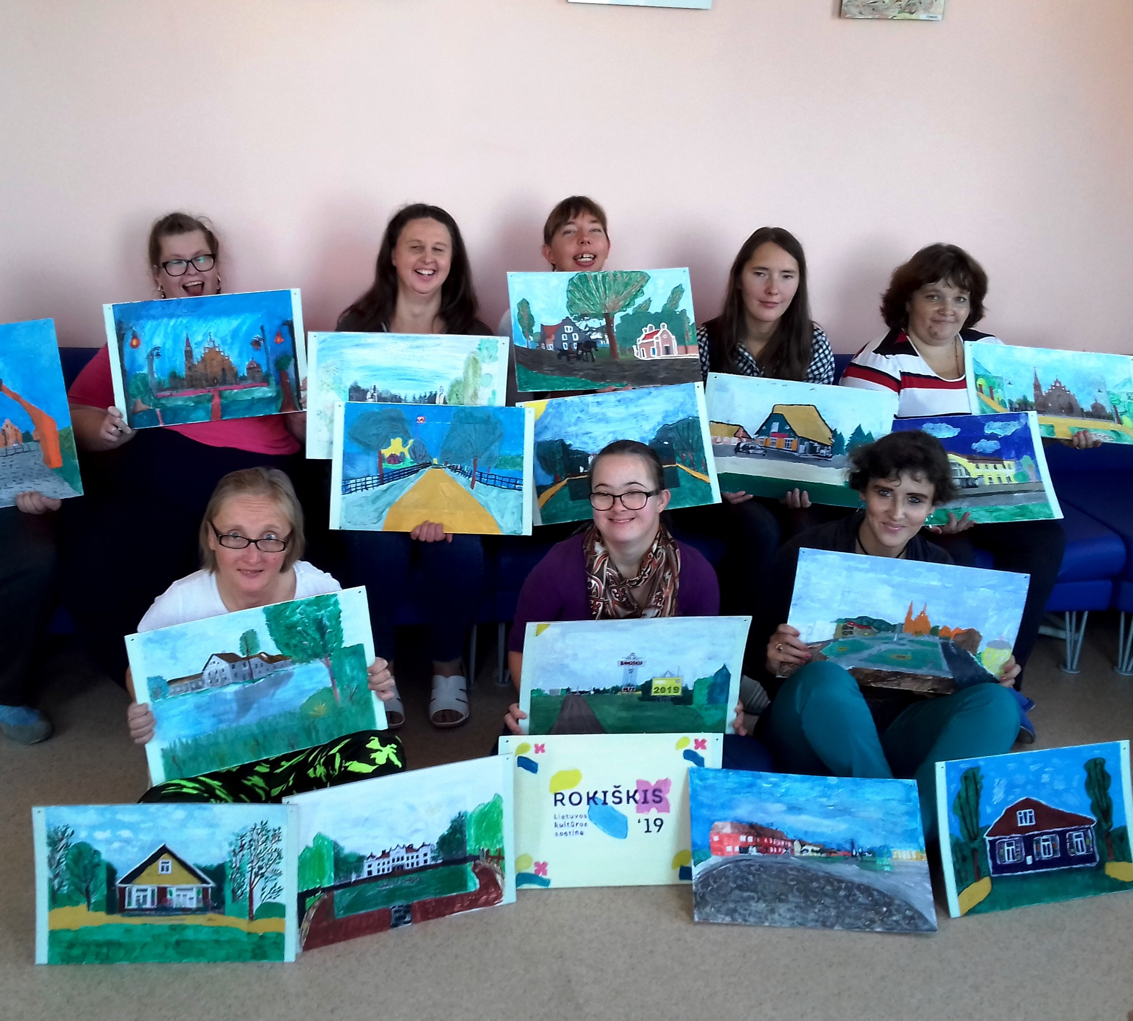
Day Care
Social self-care home
Center for social competences development
Social asisstance at home
Special and social transportation asisstance

Slide 12
Elderly Home

Slide 13
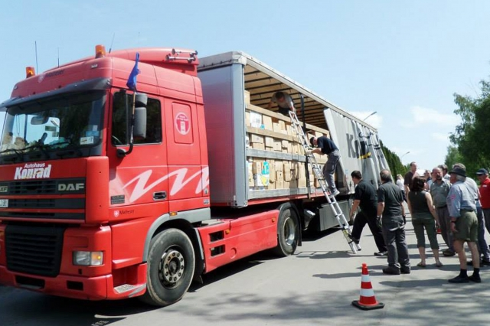
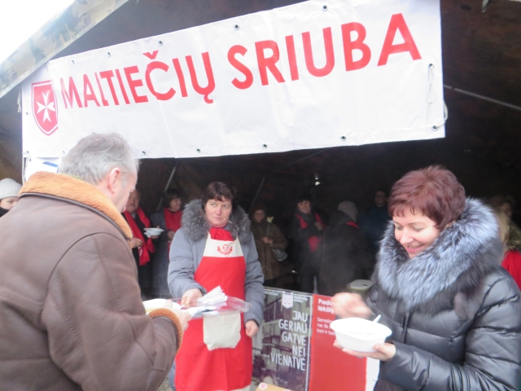
Estenfeld Malteser bring food and daily tools for the poor

