Slide 1


Meerssen / Netherlands
Juniors for seniors ageing
Presentation Judenburg September 23rd 2021

Slide 2
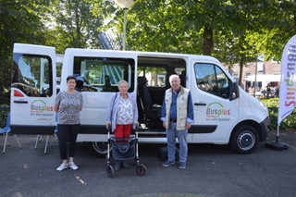
Meerssen: Wheelchair Friendly?

Slide 3
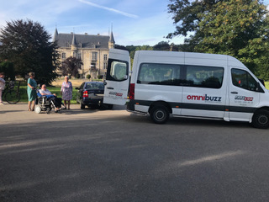
Meerssen: Wheelchair Friendly?

Slide 4
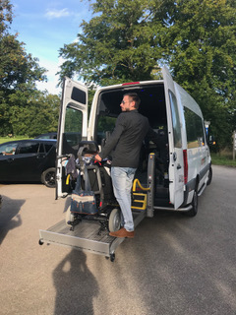
Meerssen: Wheelchair Friendly?

Slide 5
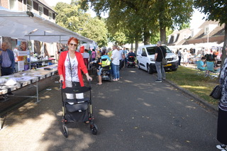
Meerssen: Wheelchair Friendly?

Slide 6
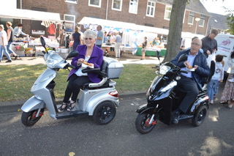
Meerssen: Wheelchair Friendly?

Slide 7
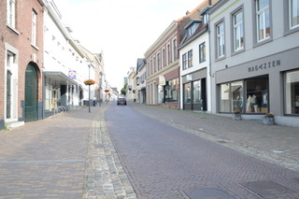
Meerssen: Wheelchair Friendly?

Slide 8
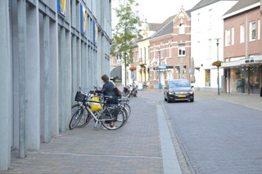
Meerssen: Wheelchair Friendly?

Slide 9
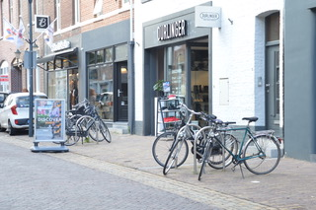
Meerssen: Wheelchair Friendly?

Slide 10
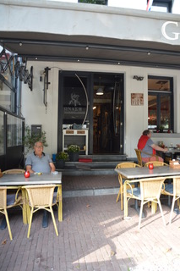
Meerssen: Wheelchair Friendly?

Slide 11
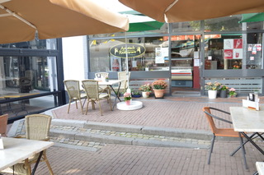
Meerssen: Wheelchair Friendly?

Slide 12
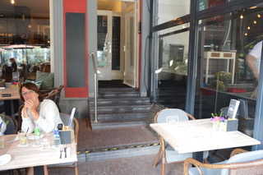
Meerssen: Wheelchair Friendly?

Slide 13
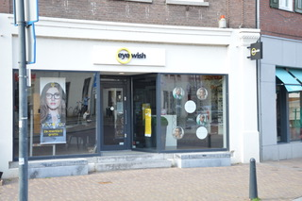
Meerssen: Wheelchair Friendly?

Slide 14
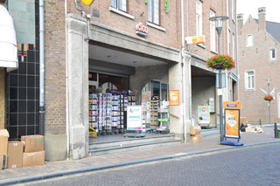
Meerssen: Wheelchair Friendly?

Slide 15
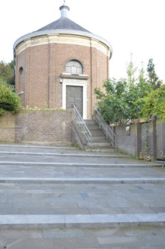
Meerssen: Wheelchair Friendly?

