Slide 1

Transportation
Barriers, solutions
Kőszeg, Hungary
Kőszeg, Hungary

Slide 2
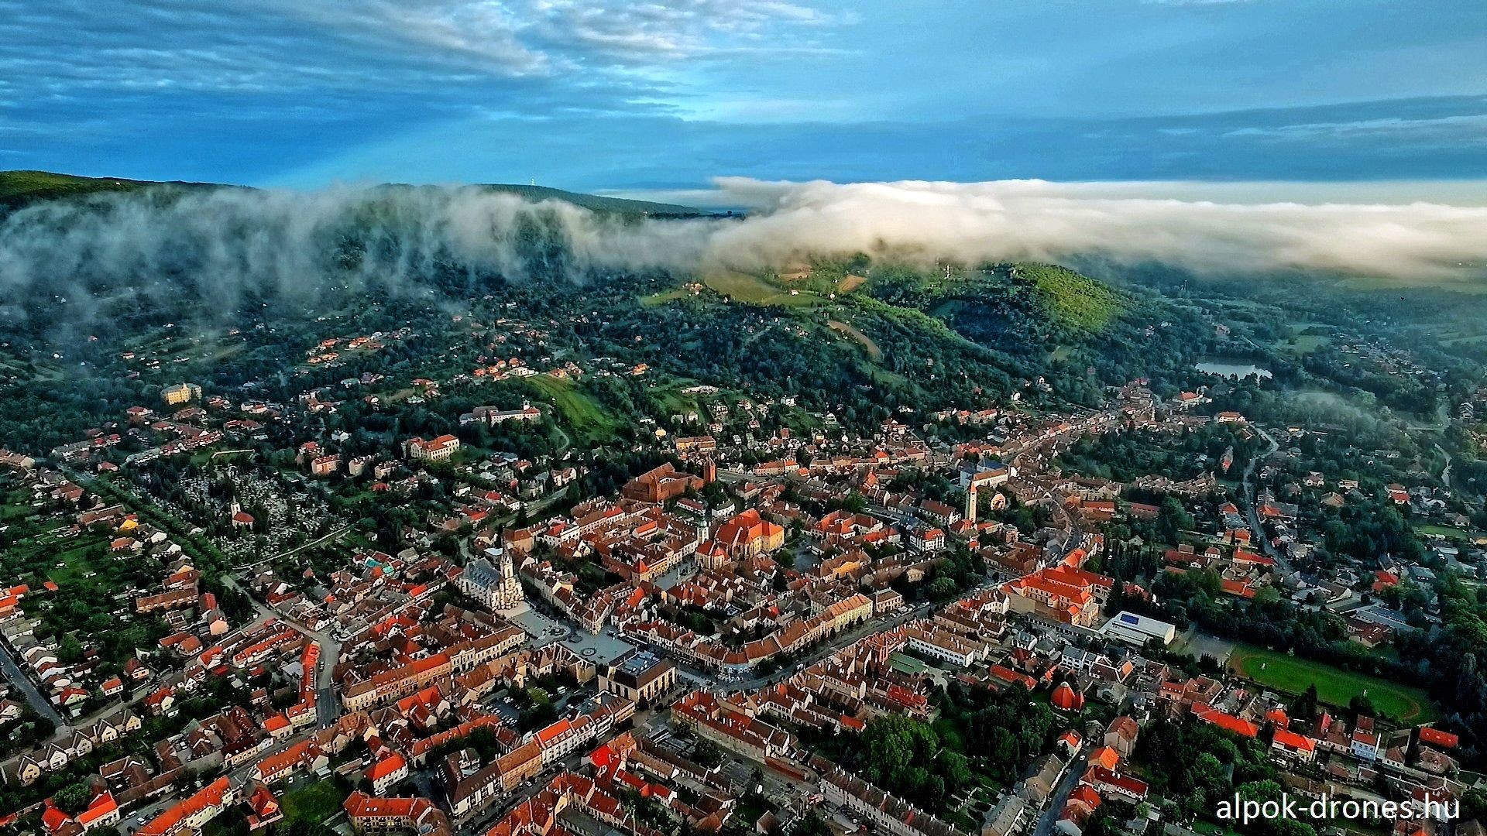
Kőszeg, Hungary

Slide 3
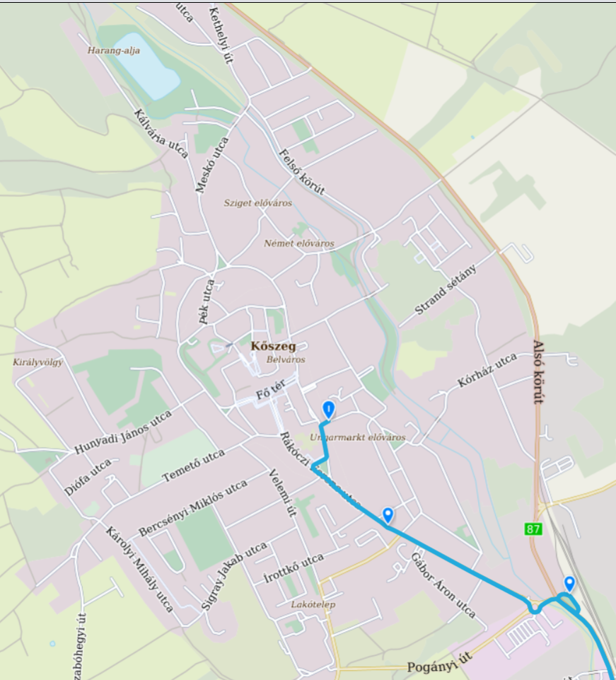
Small town,
Not too big distances, but…
Kőszeg, Hungary

Slide 4
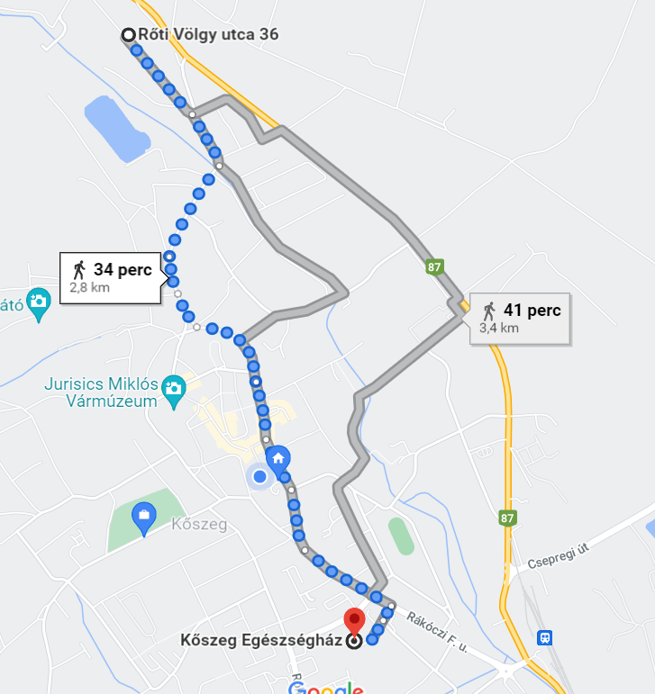
If you are sick
w/o a car
Kőszeg, Hungary

Slide 5
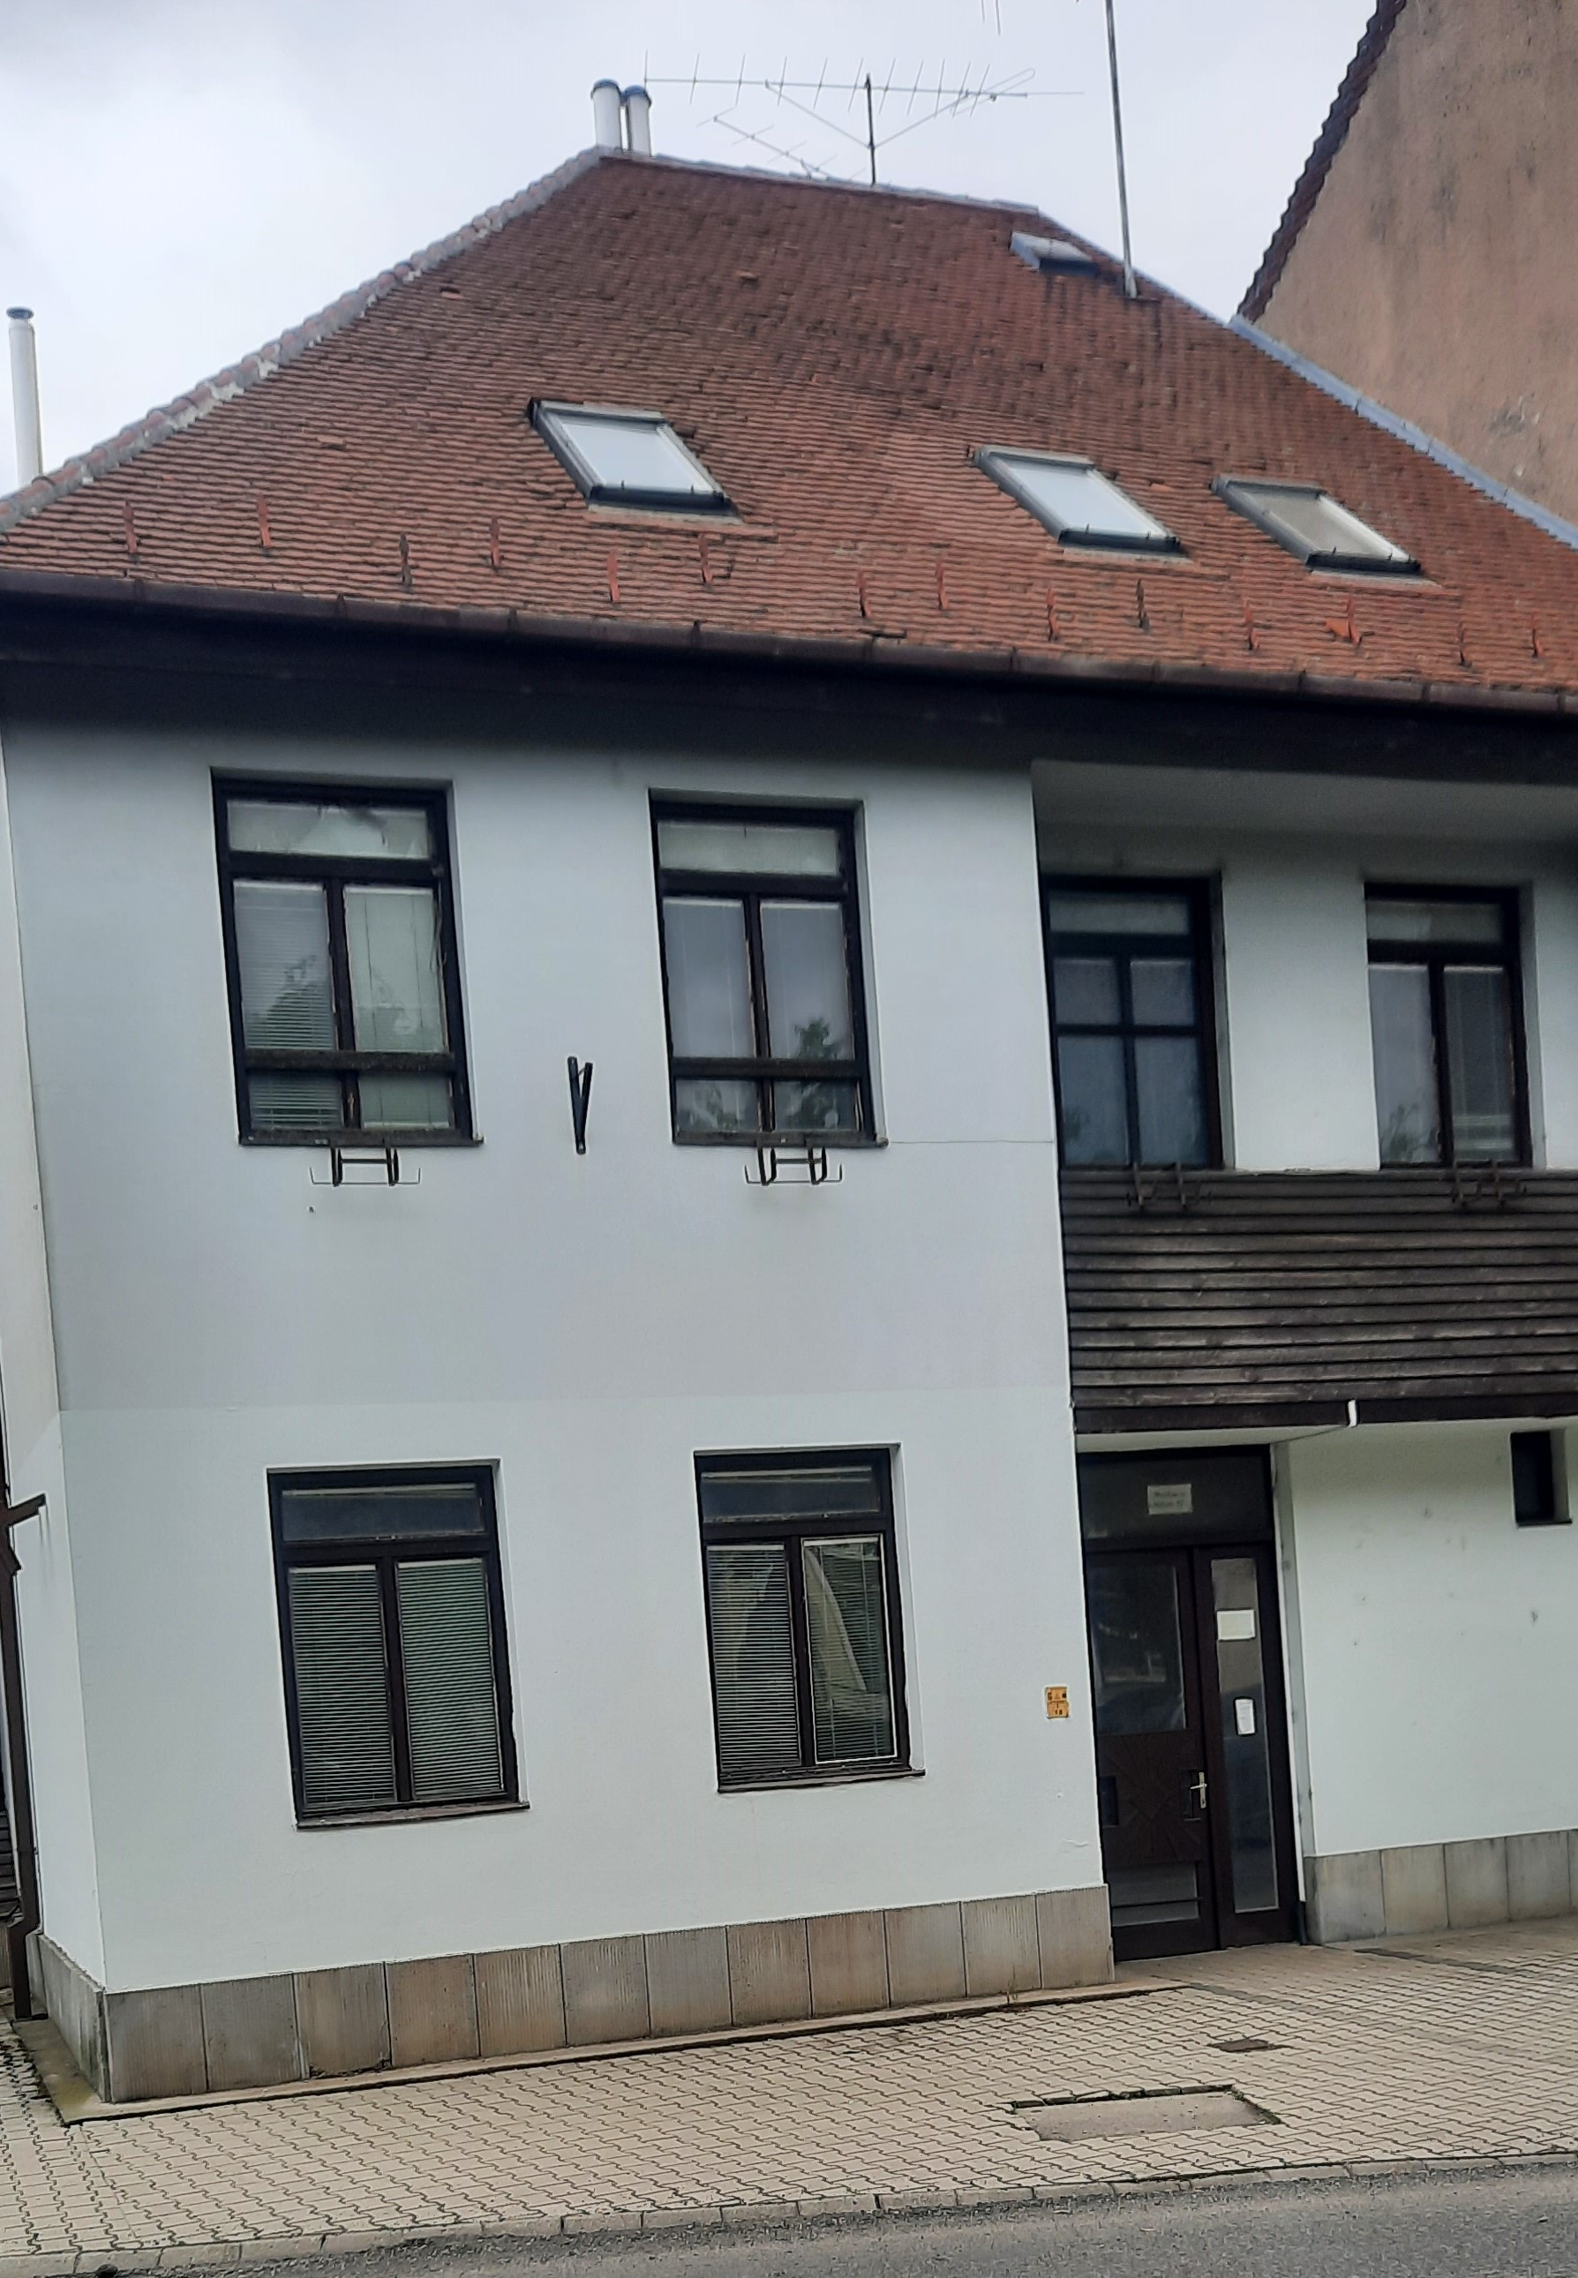
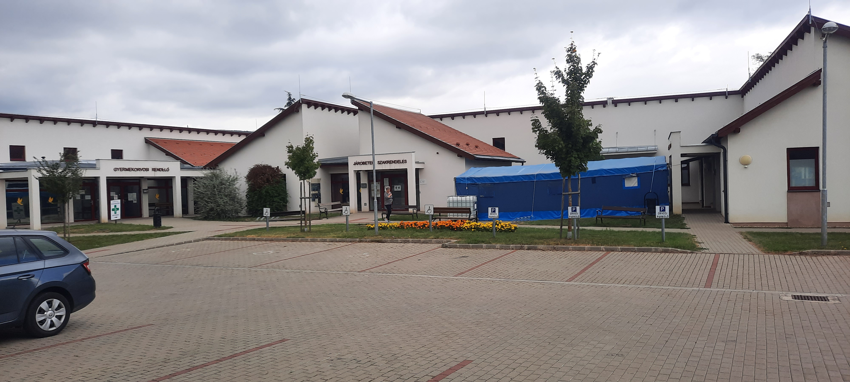
Health care center
Kőszeg, Hungary

Slide 6
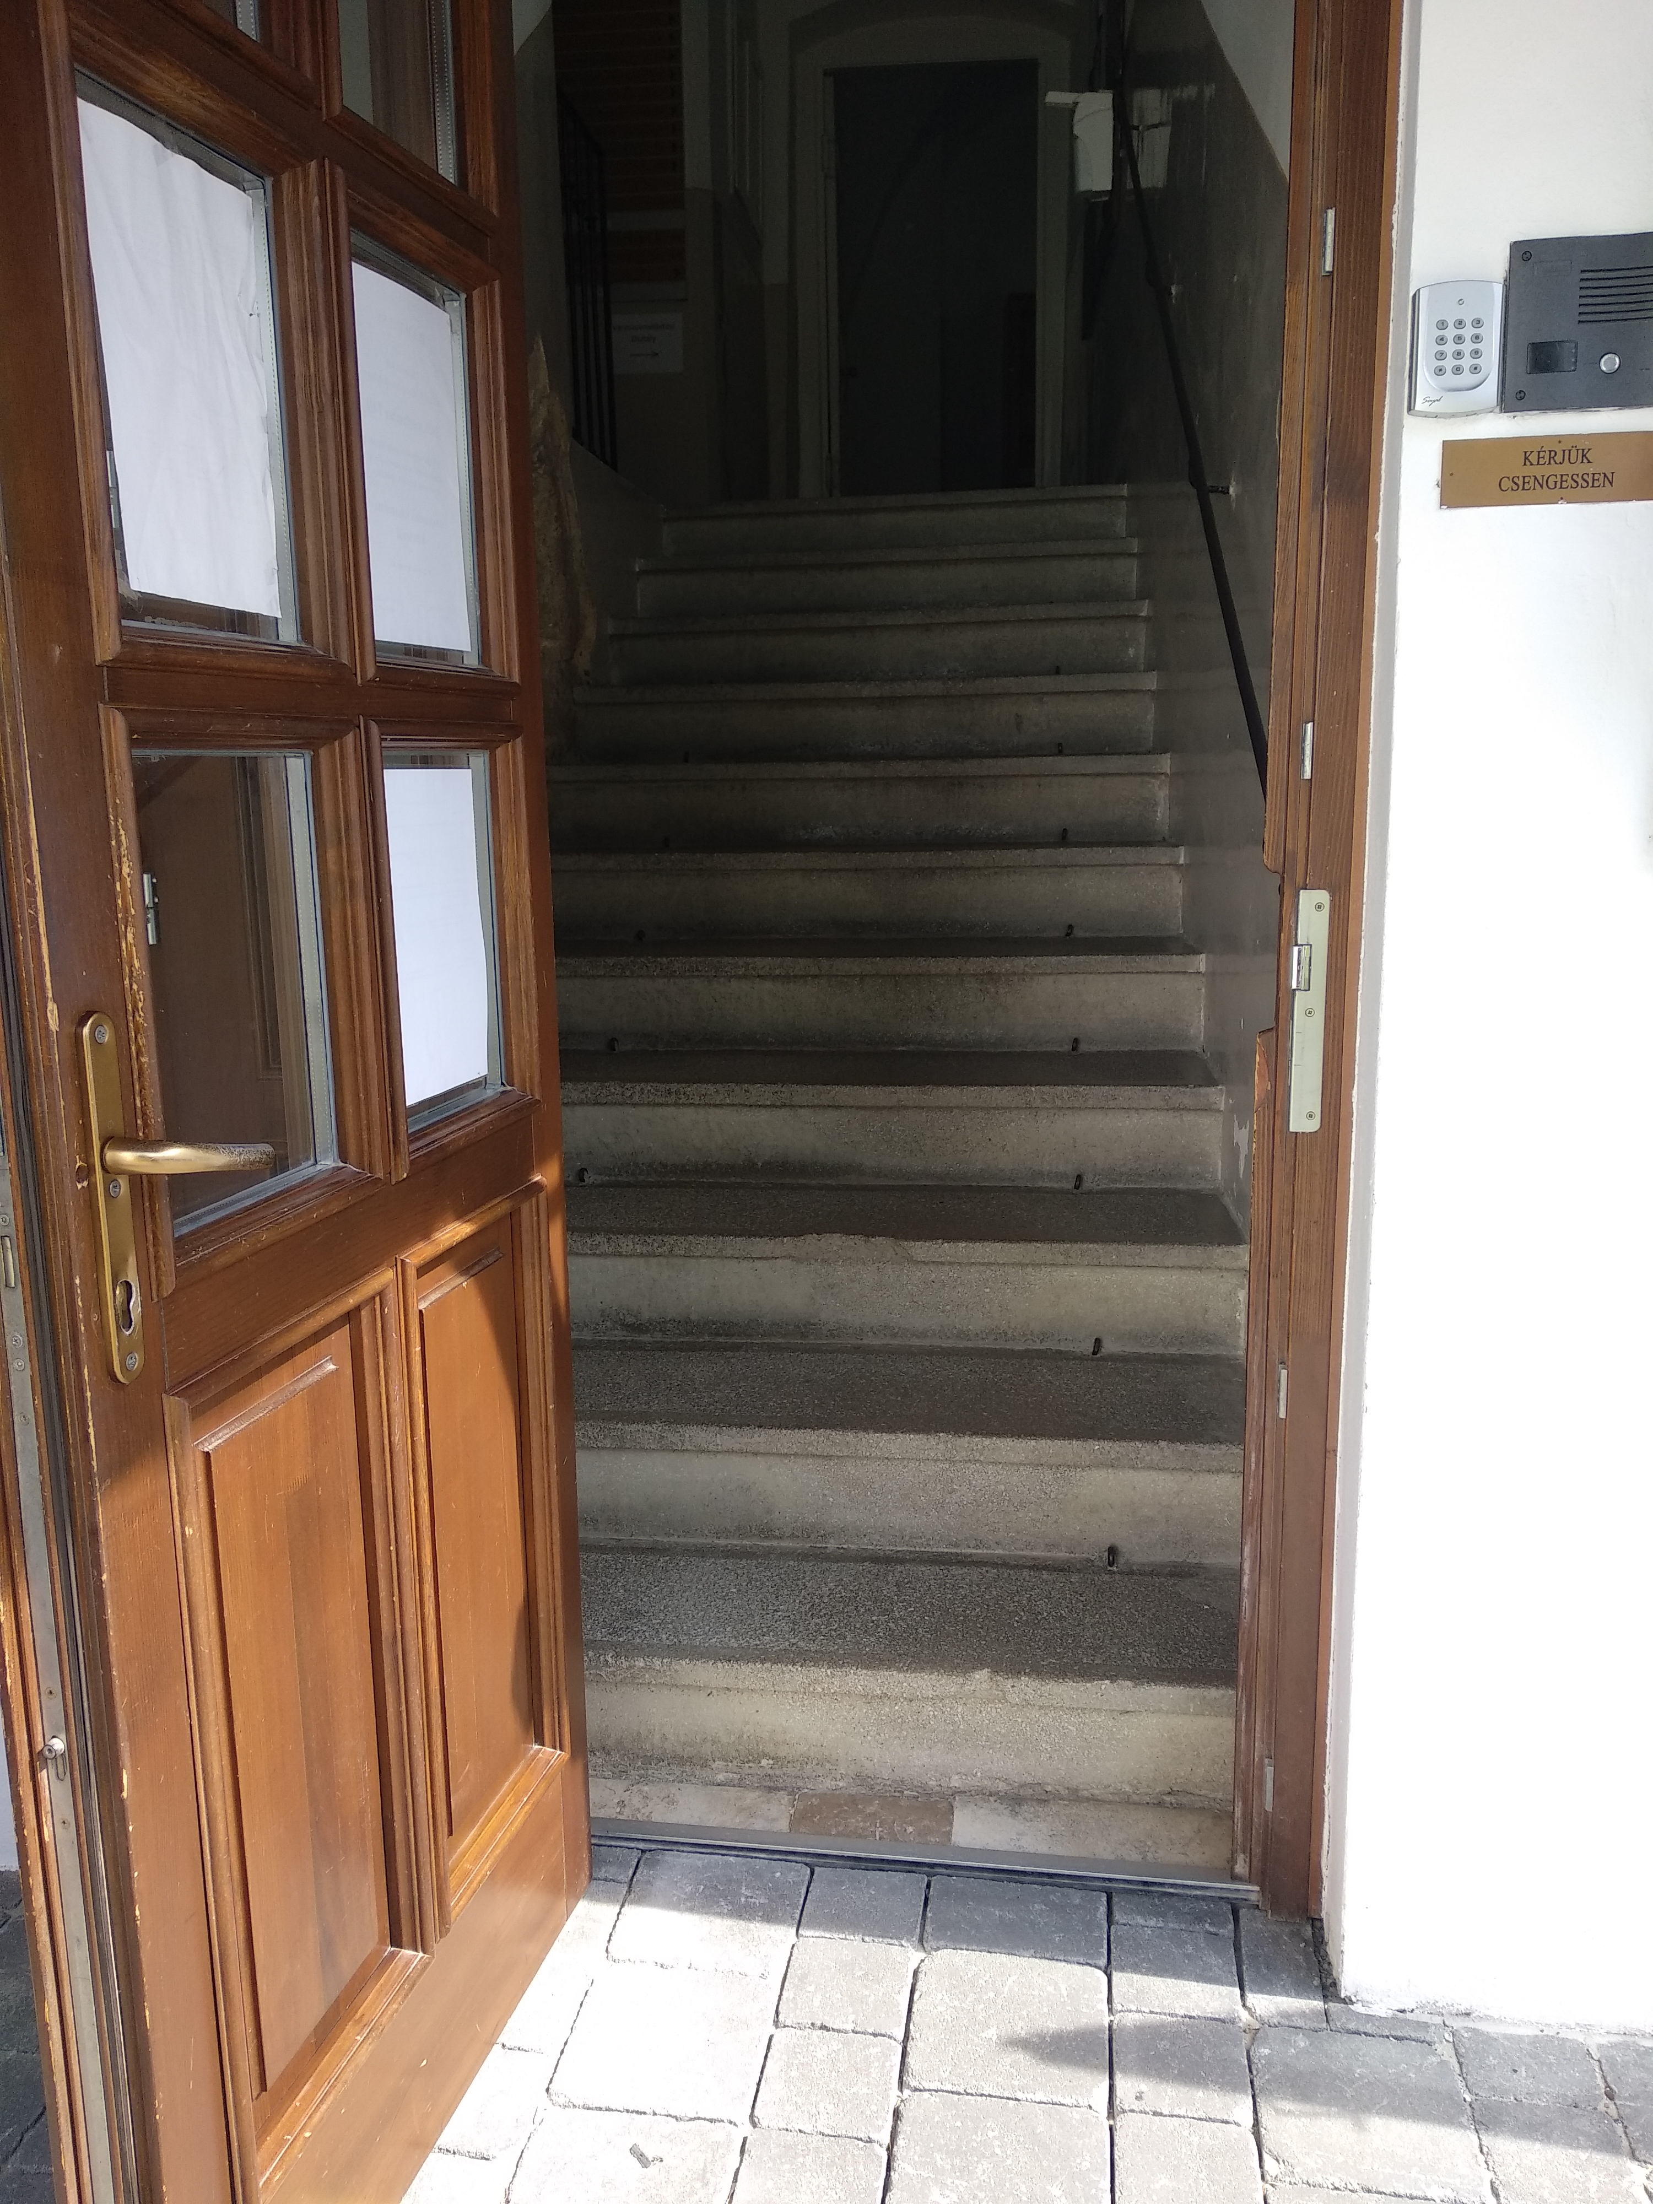
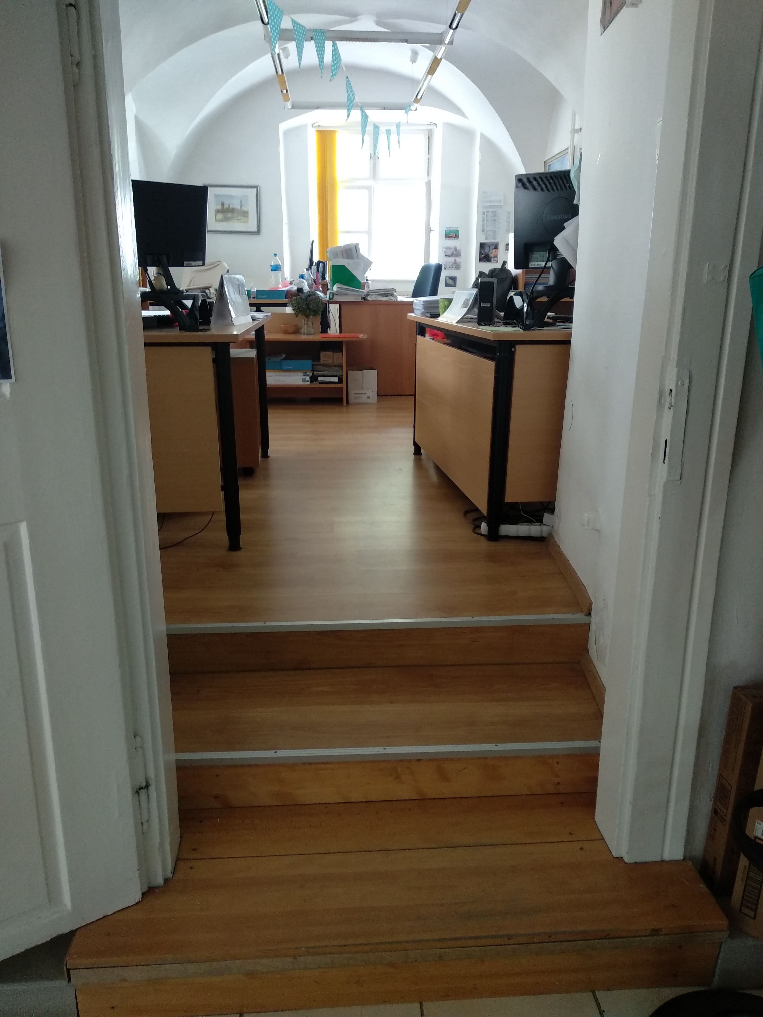
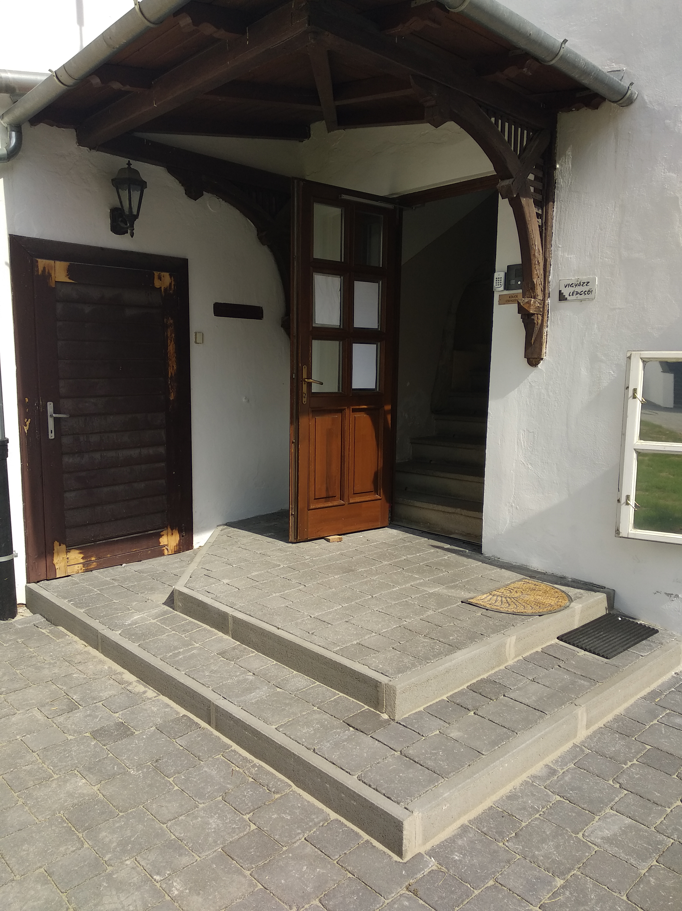
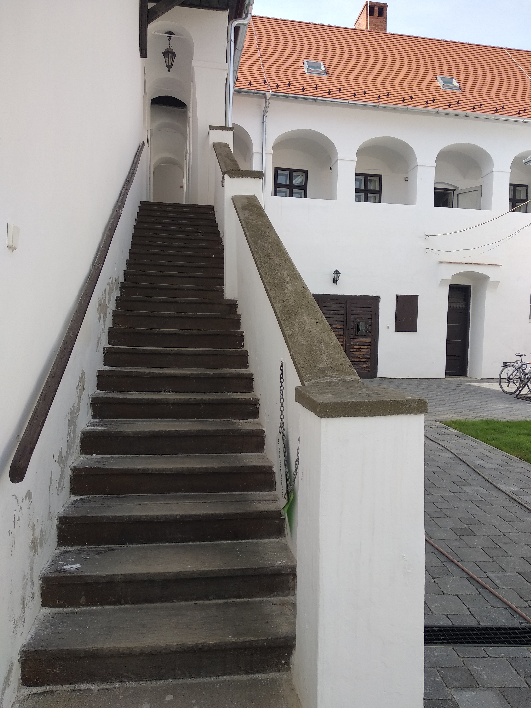
Let’s go to the town hall
Kőszeg, Hungary

Slide 7
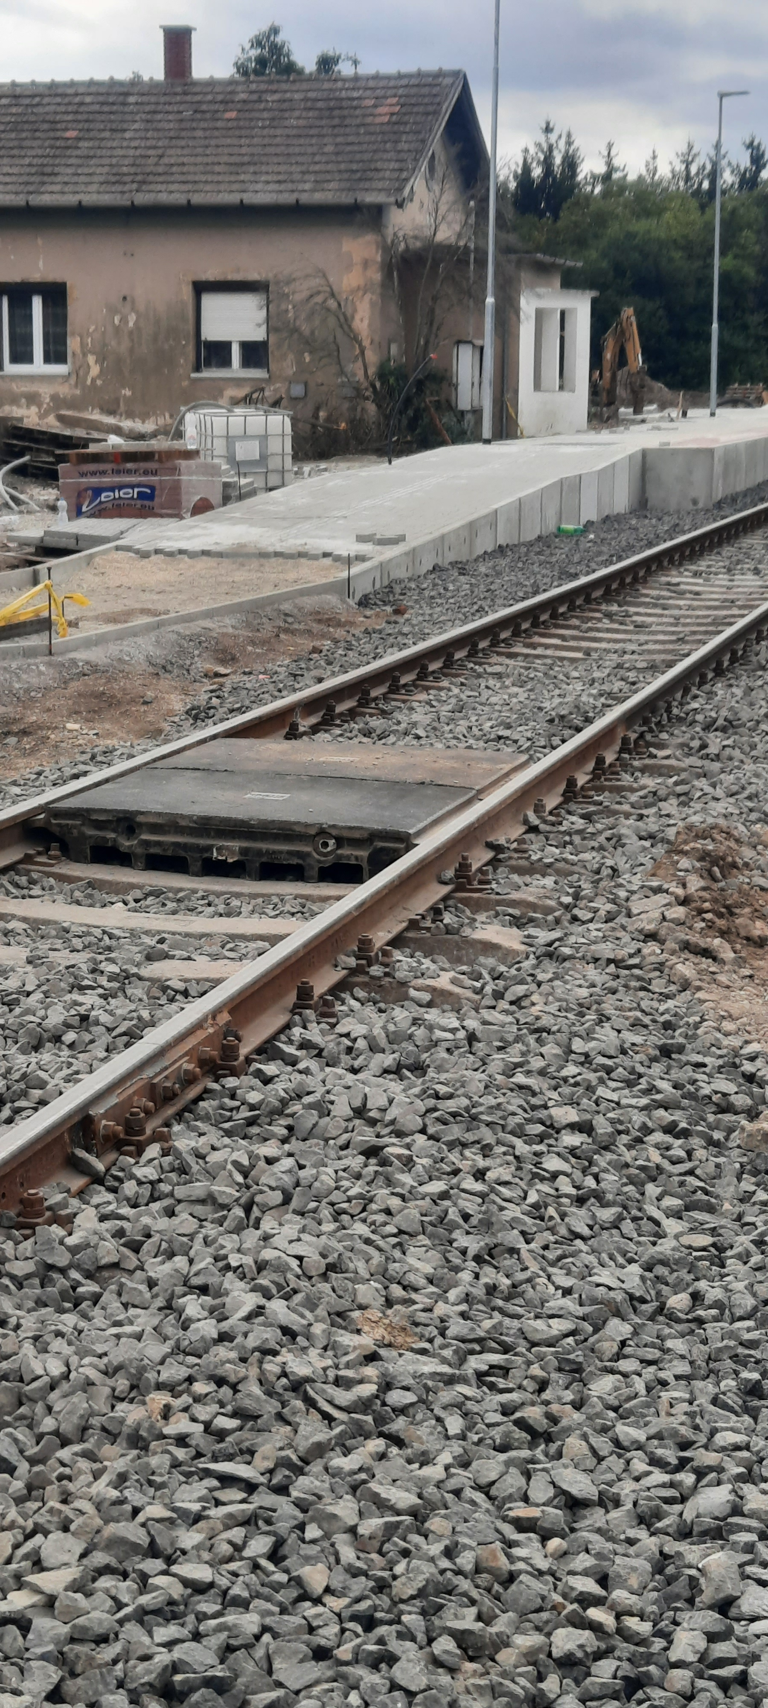
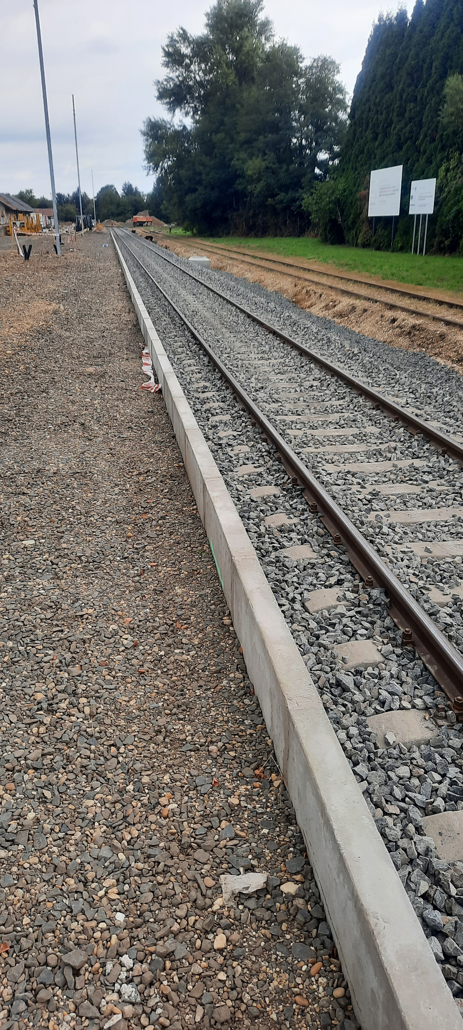
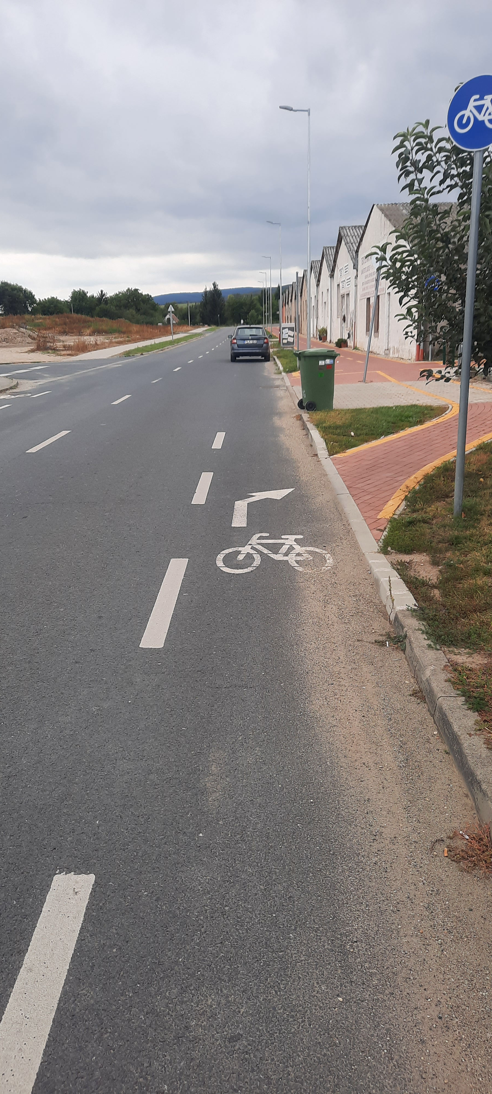
Big effort, Much work is done
Kőszeg, Hungary

Slide 8
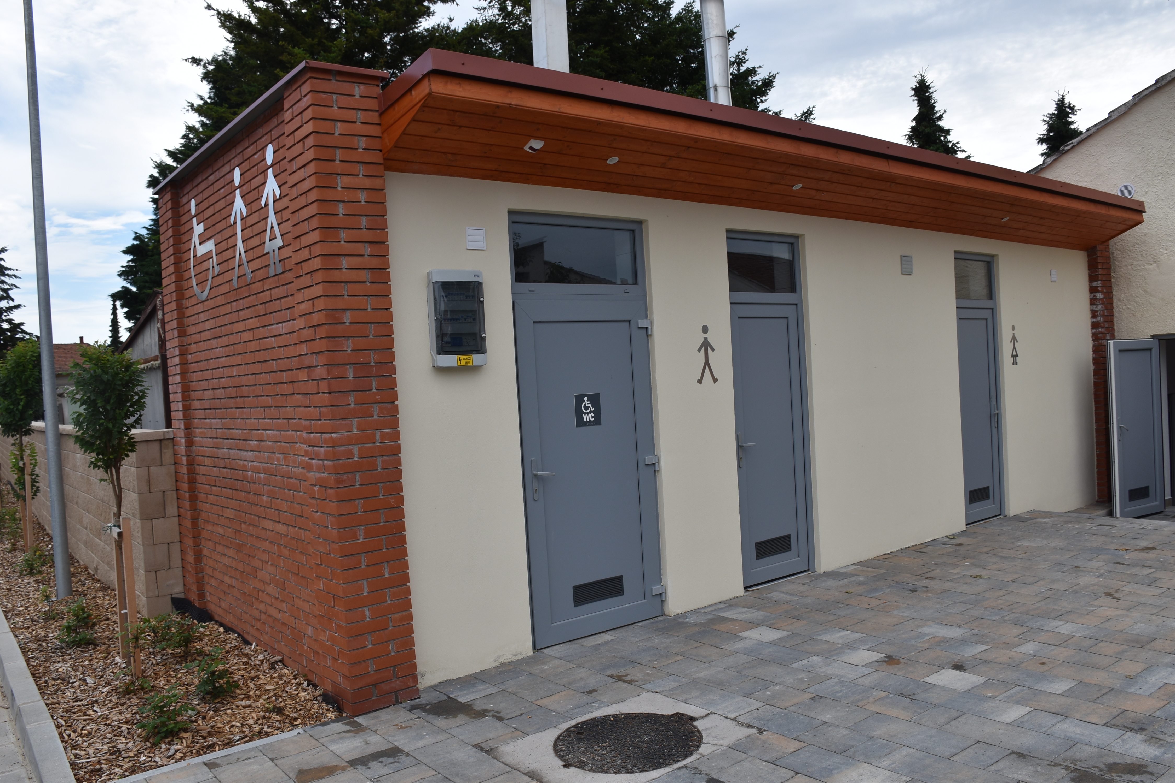
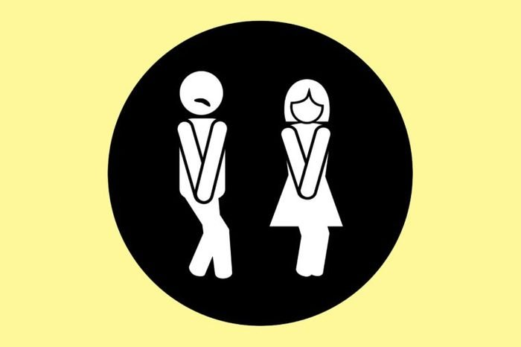
IF YOU MUST GO…
At the Market
BUT very rare
Kőszeg, Hungary

Slide 9
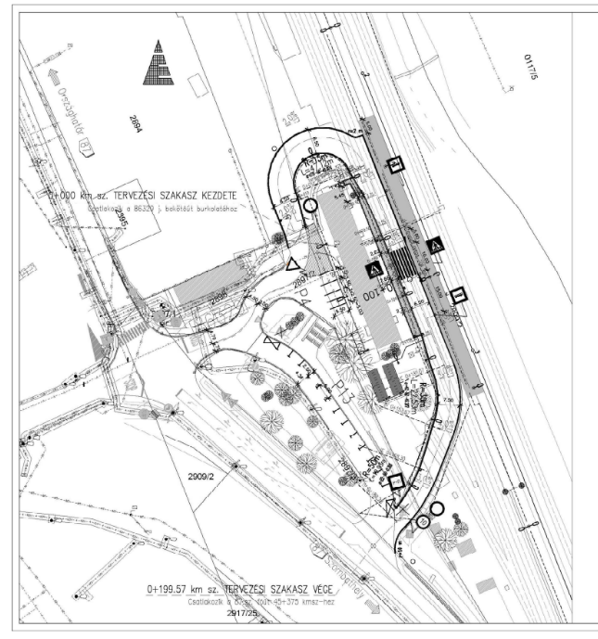
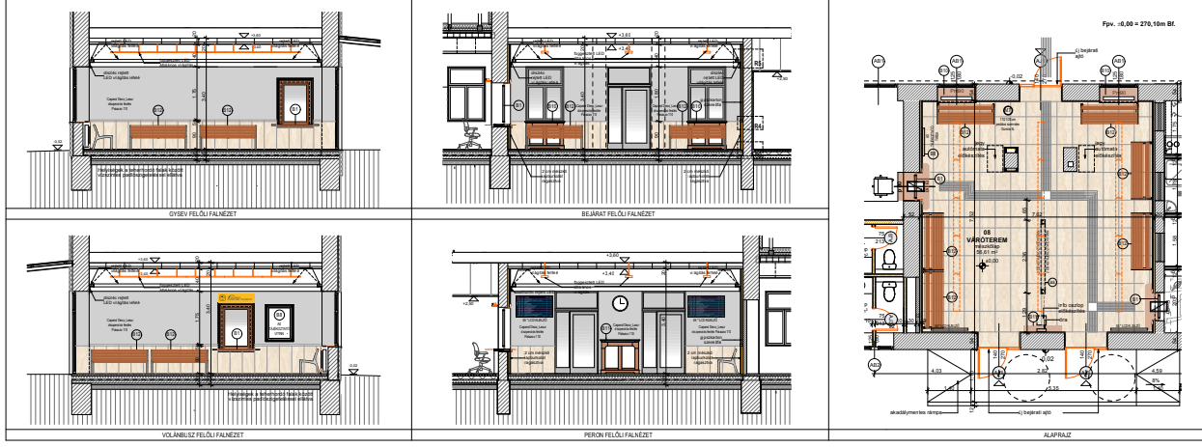
New railway station + bus station
Kőszeg, Hungary

Slide 10
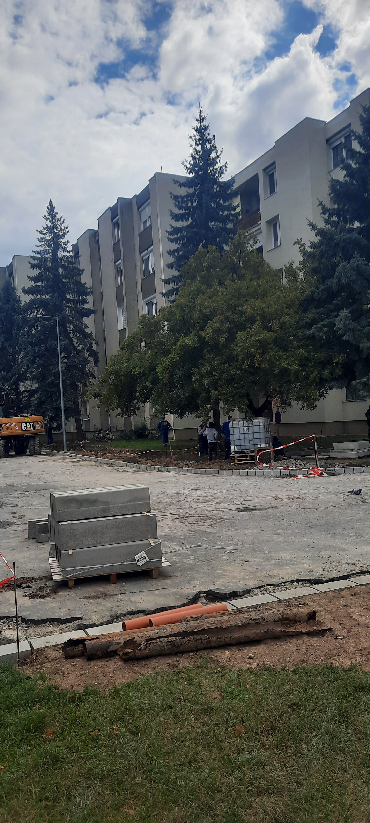
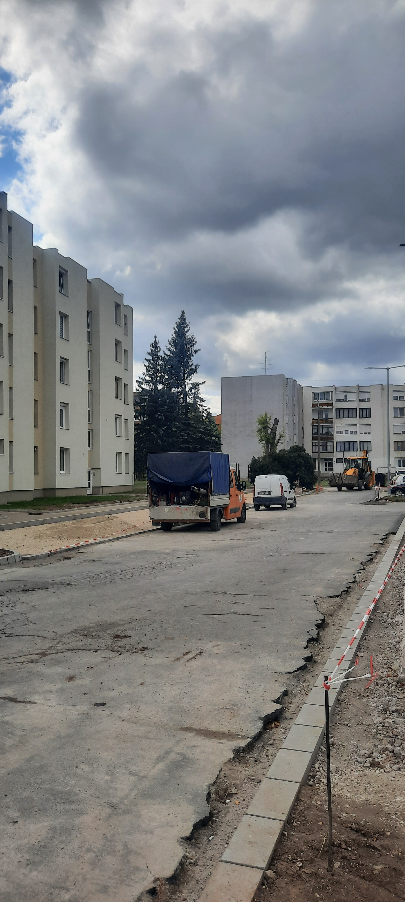
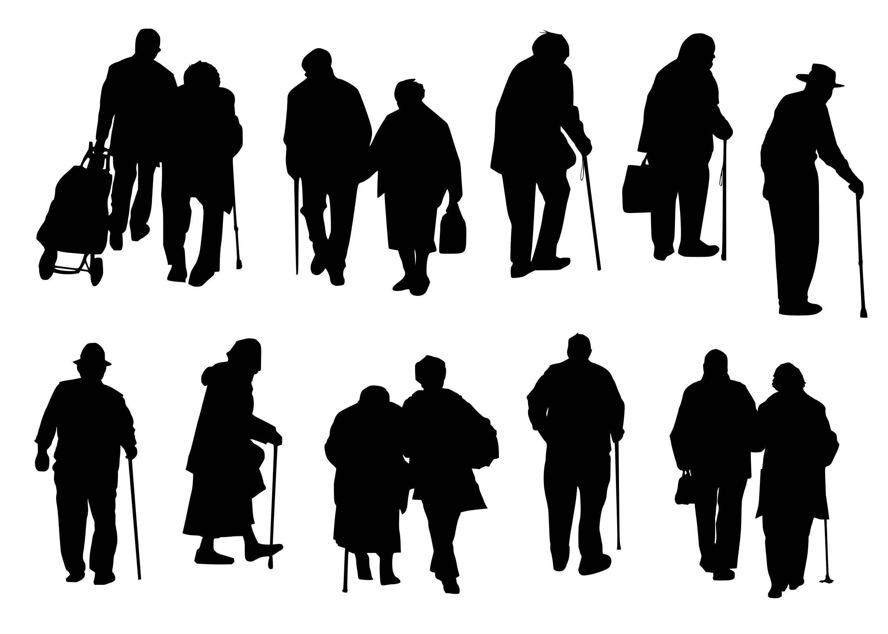
And we arrive home
Kőszeg, Hungary

Slide 11
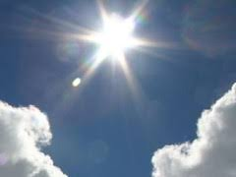
But we hope
Kőszeg, Hungary

