Slide 1



Judenburg
Workshop
Judenburg, 24.9.2021

Slide 2
Age structure and living situation

Slide 3
Current situation
Railway station: direct trains to Vienna, Klagenfurt, Venezia
Bus: several regional bus lines (main line runs all 15 minutes)
Citybus: We have an own bus for the city

Slide 4
Ideas and Projects
New ticketing system for public transport will start on Oct 26.th
Relaunch of the “City bus”
Special transport service JuMobil: on-call bus for people with reduced mobility
„Active in the park“ project: exercise at multigenerational playground
Project „Berollbares Judenburg“ (rollable Judenburg)
Challenge: Almost all empty shops have a problem with accessibility

Slide 5
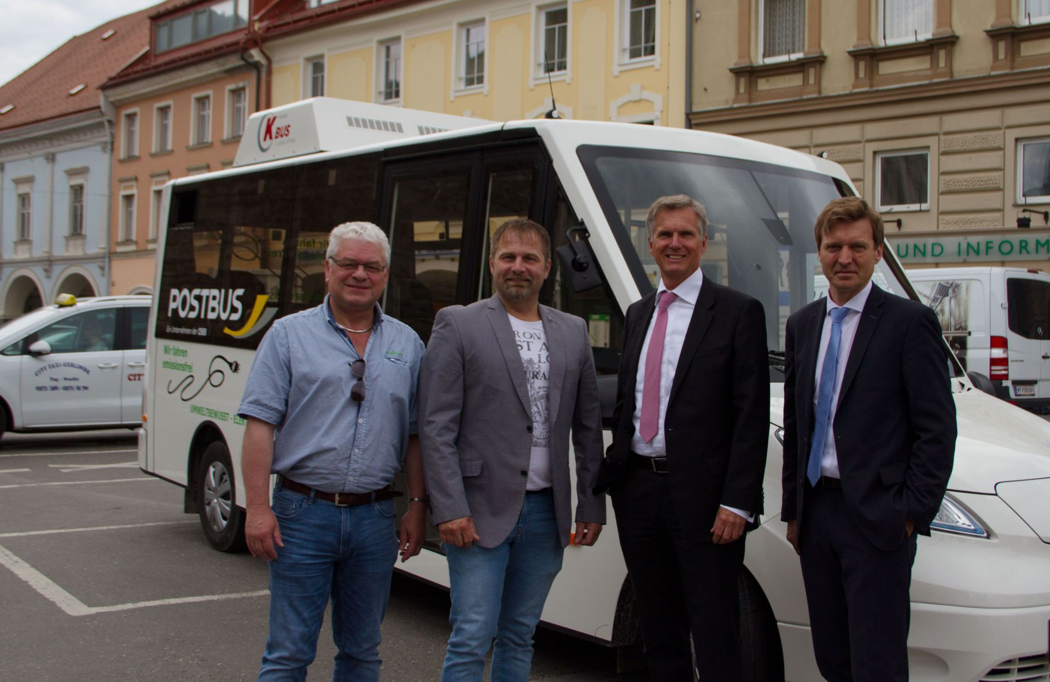
Challenges
Share of old people in the total population is increasing
Rising costs for communities for senior care
Staff shortage in the nursing sector
Private homes are usually not barrier-free - people with reduced mobility cannot get out of the house
Loneliness in old age

Slide 6
