Slide 1


Juniors for Seniors – active ageing
Juniors for Seniors – active ageing
5th Event Bad Kötzting, 21. - 23. April 2022

Slide 2
Flats for Seniors
Questionnaire analisy
Juniors for Seniors – active ageing
5th Event Bad Kötzting, 21. - 23. April 2022
Miha Ješe
Nina Štibelj
Igor Medič

Slide 3
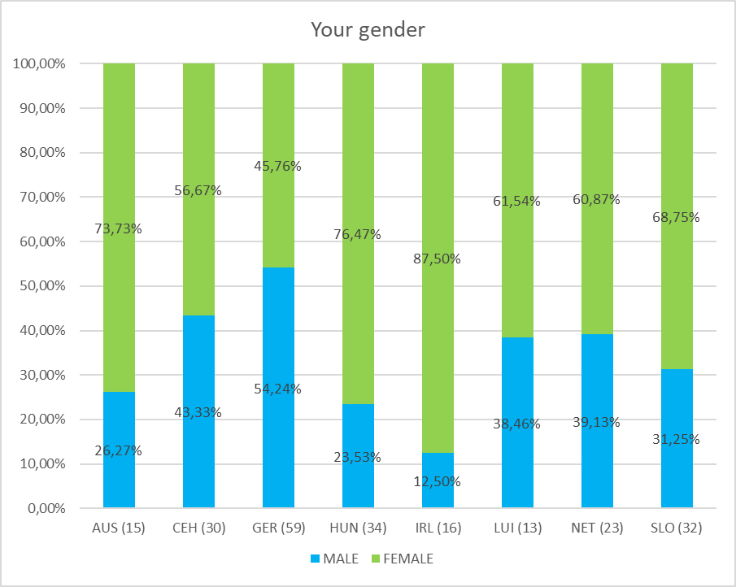
Juniors for Seniors – active ageing

Slide 4
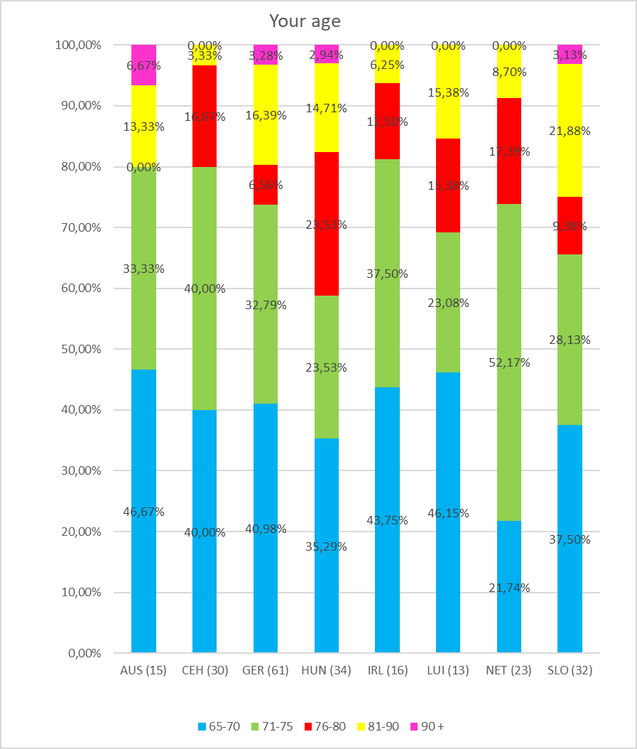
Juniors for Seniors – active ageing

Slide 5
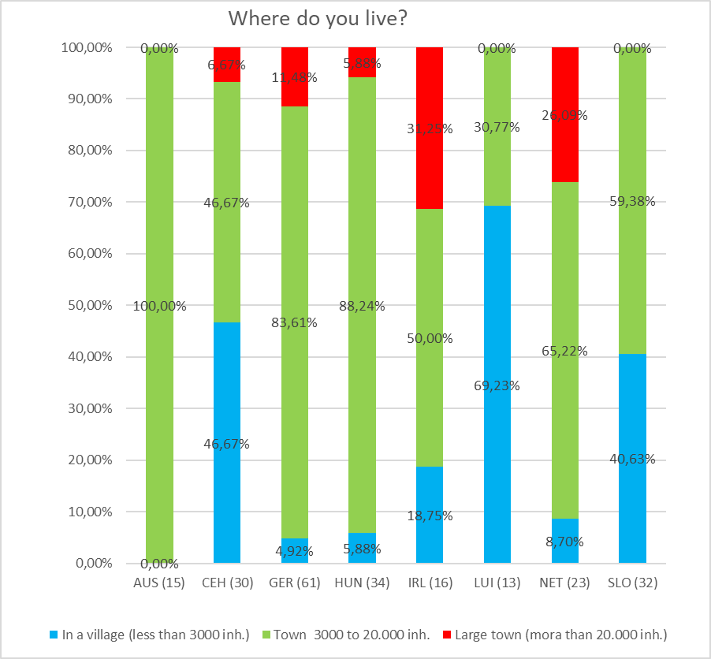
Juniors for Seniors – active ageing

Slide 6
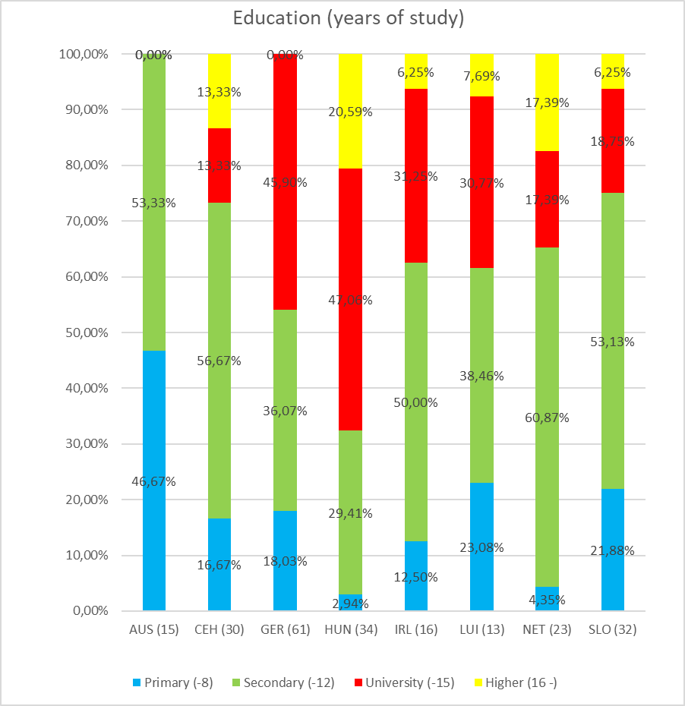
Juniors for Seniors – active ageing

Slide 7
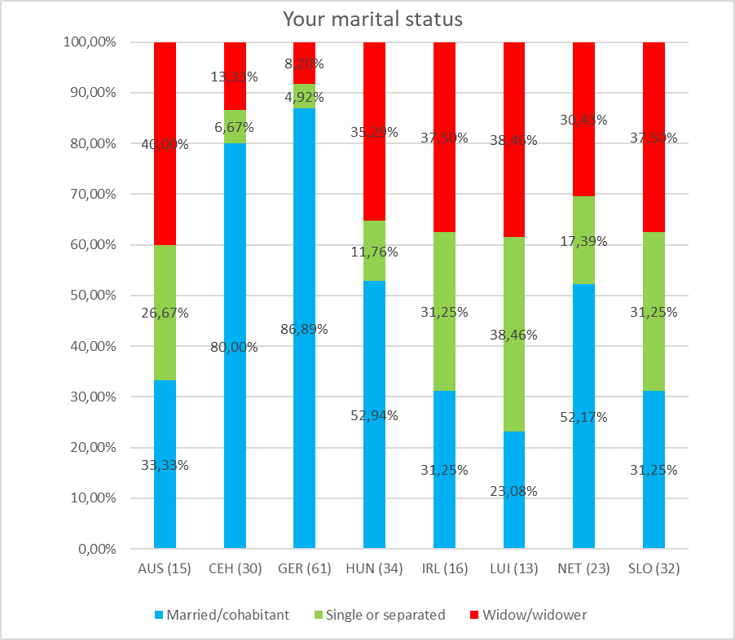
Juniors for Seniors – active ageing

Slide 8
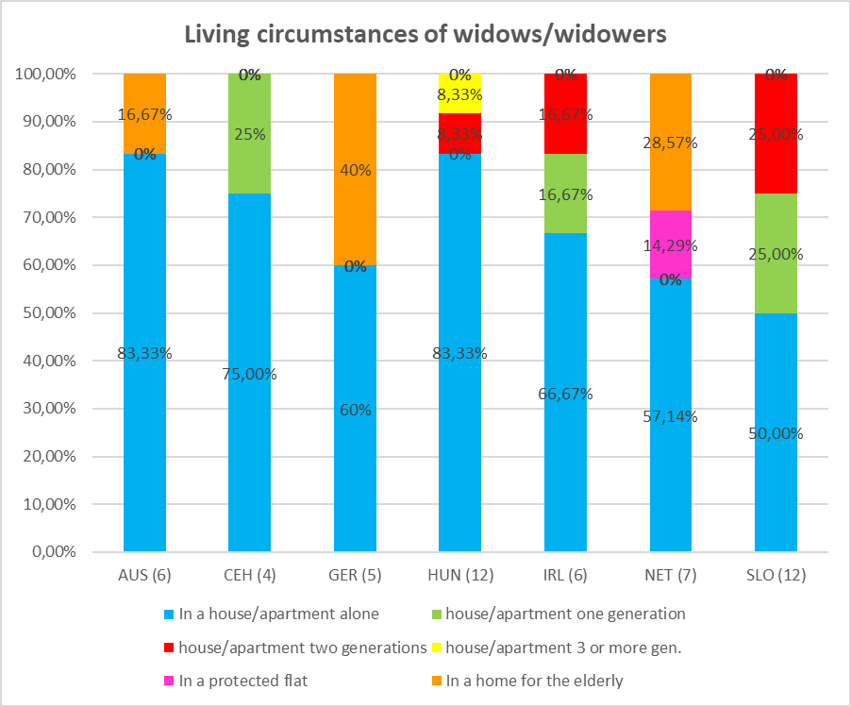
Juniors for Seniors – active ageing

Slide 9
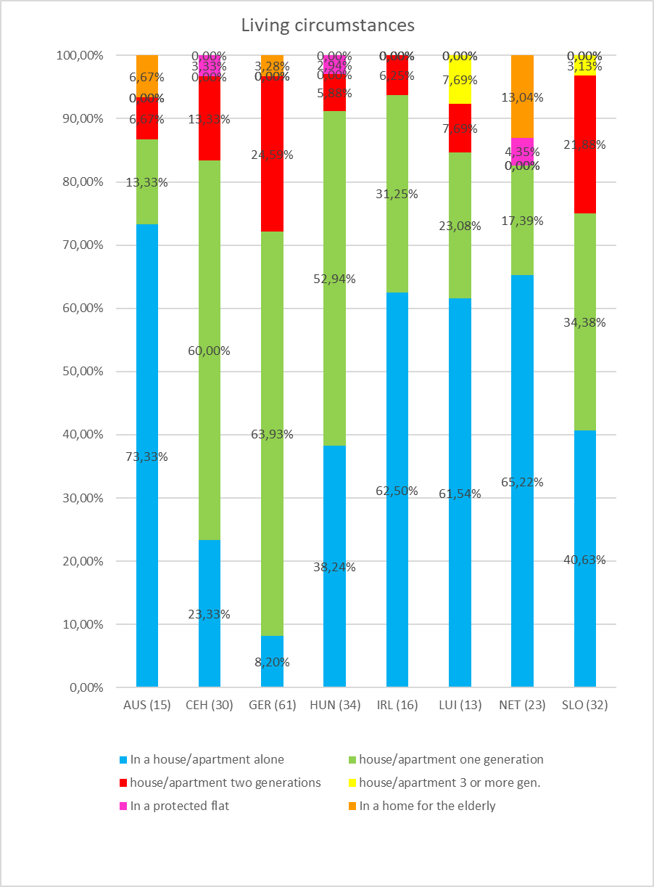
Juniors for Seniors – active ageing

Slide 10
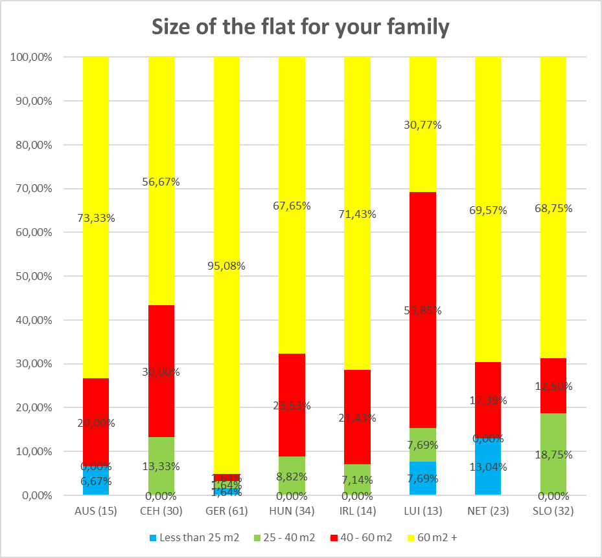
Juniors for Seniors – active ageing

Slide 11
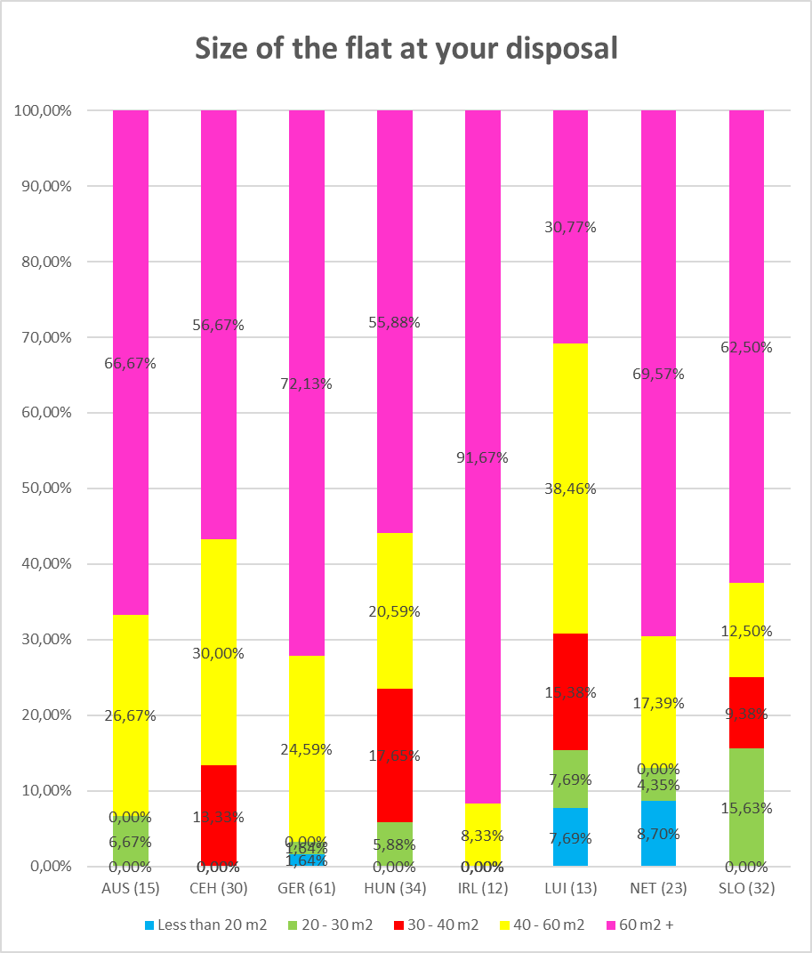
Juniors for Seniors – active ageing

Slide 12
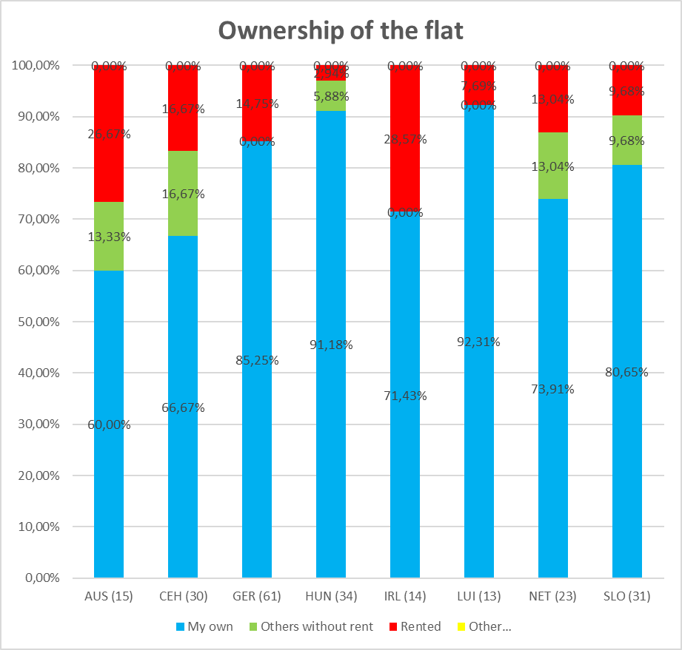
Juniors for Seniors – active ageing

Slide 13
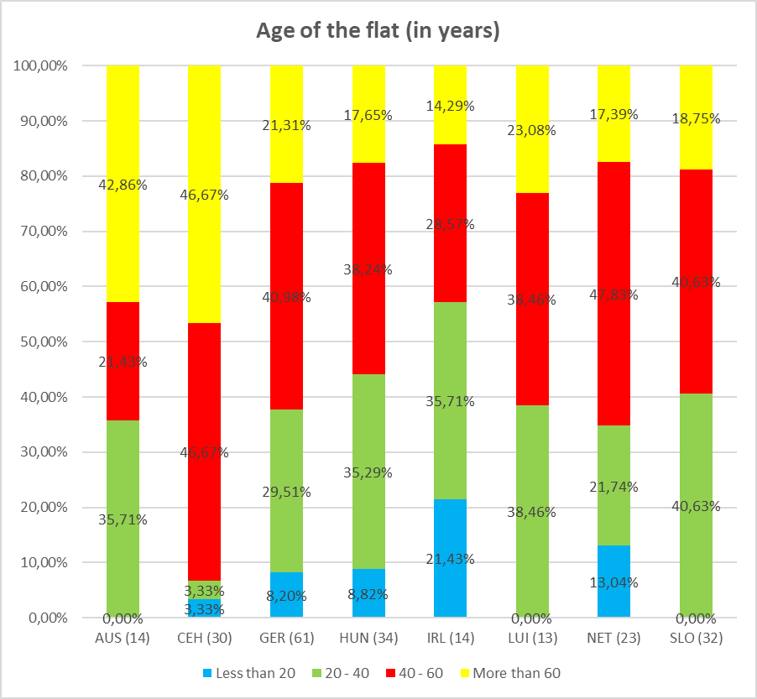
Juniors for Seniors – active ageing

Slide 14
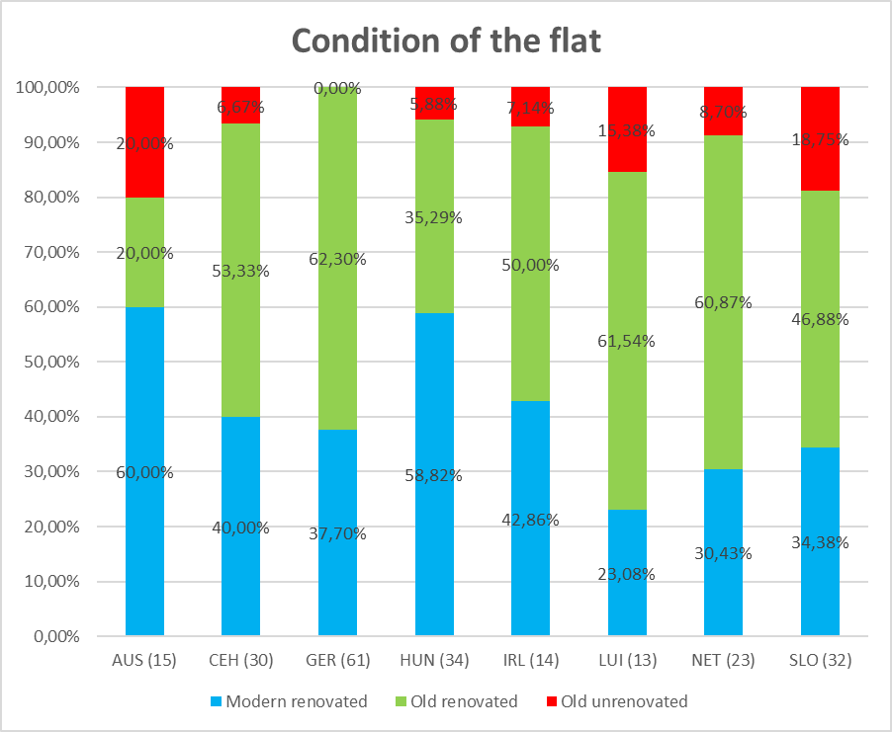
Juniors for Seniors – active ageing

Slide 15
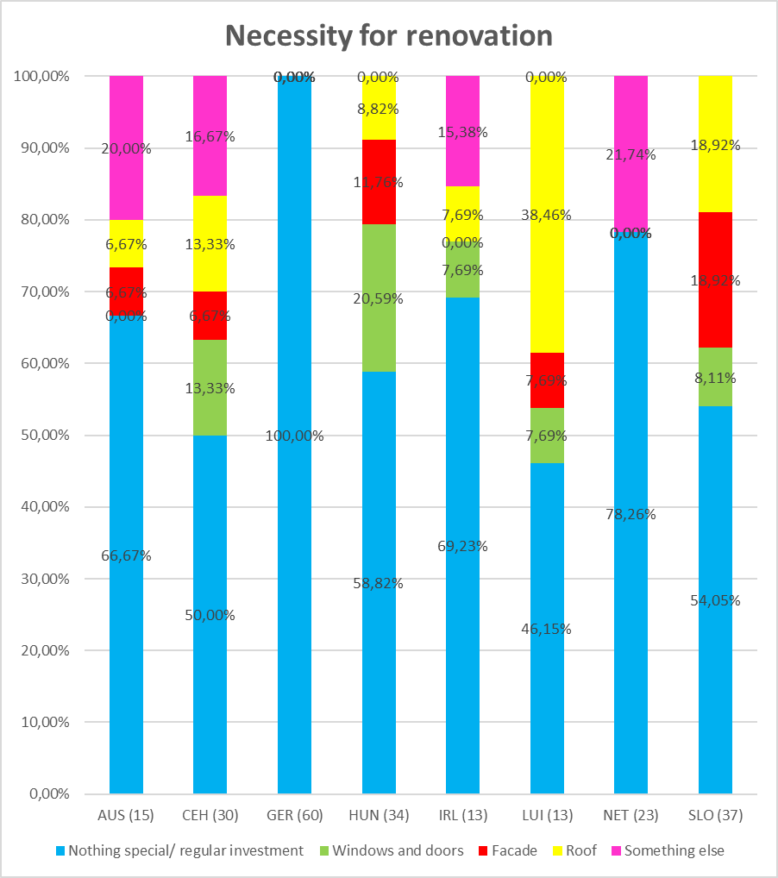
Juniors for Seniors – active ageing

Slide 16
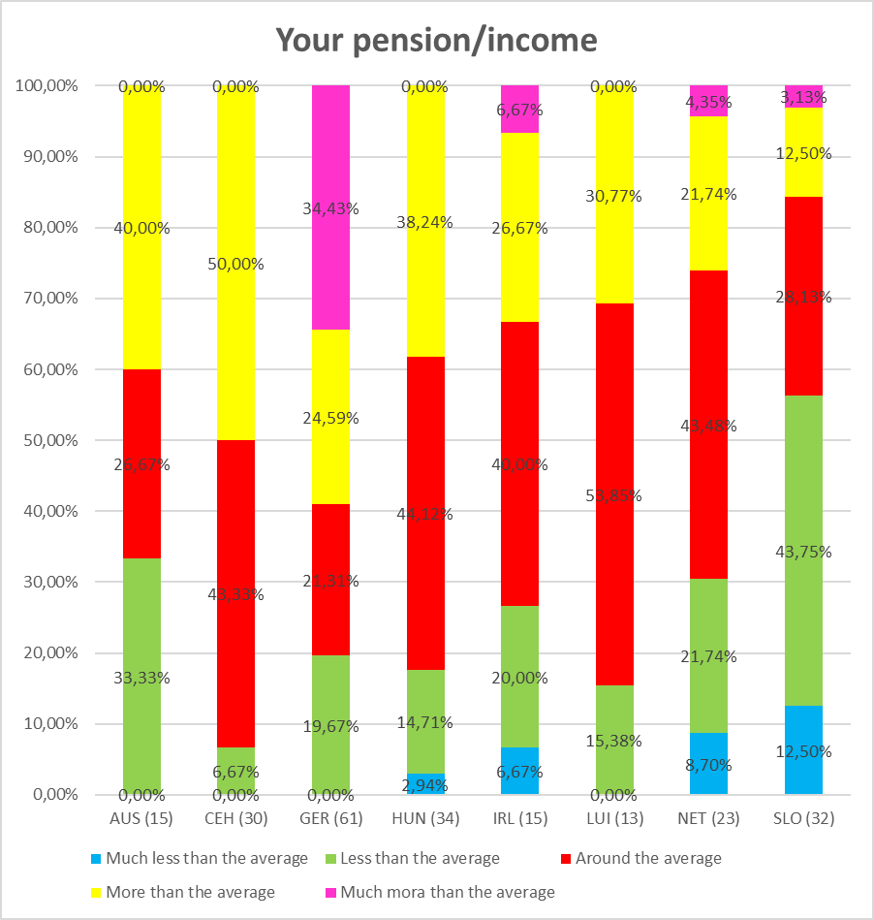
Juniors for Seniors – active ageing

Slide 17
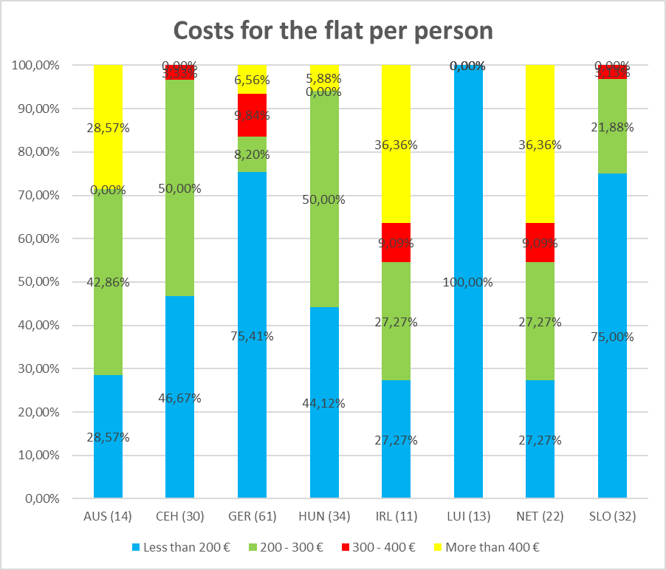
Juniors for Seniors – active ageing

Slide 18
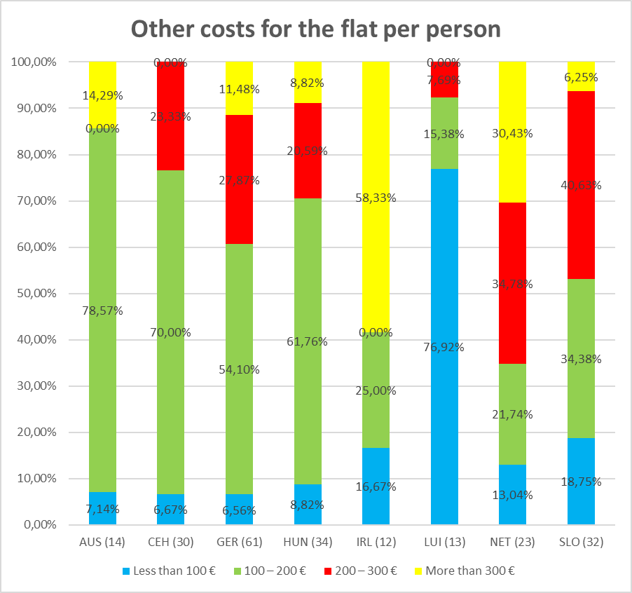
Juniors for Seniors – active ageing

Slide 19
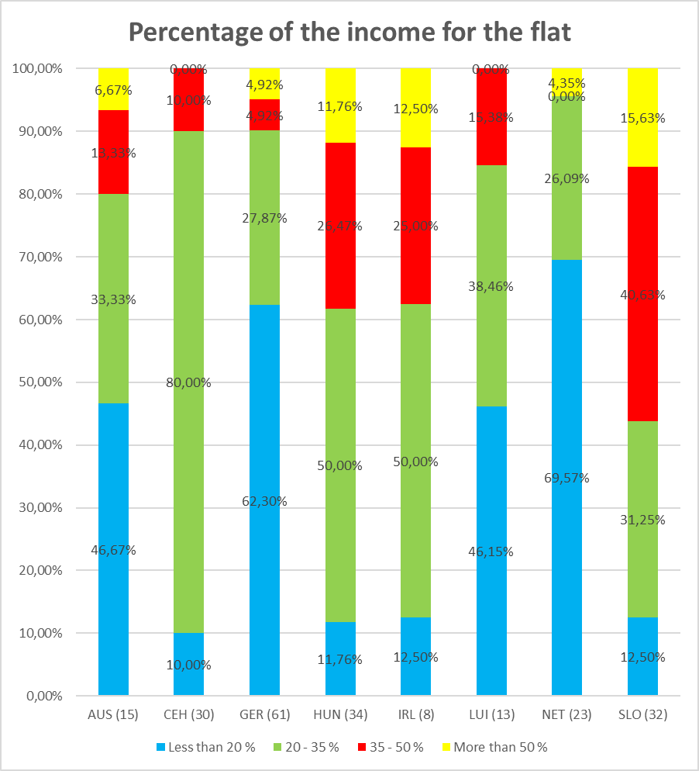
Juniors for Seniors – active ageing

Slide 20
Juniors for Seniors – active ageing
Costs for the flat over 50 % of the incomes
Town |  | AUS | CEH | GER | HUN | IRL | NET | SLO
Persons |  | 1 | 0 | 3 | 3 | 1 | 1 | 5
Size per person | less than 30 m2 | 1 | 0 | 2 | 0 | 0 | 1 | 2
 | 30 - 40 m2 | 0 | 0 | 0 | 0 | 0 | 0 | 1
 | 40 - 60 m2 | 0 | 0 | 1 | 0 | 0 | 0 | 1
 | more than 60 m2 | 0 | 0 | 0 | 3 | 1 | 0 | 1
Ownership | my own | 0 | 0 | 0 | 2 | 1 | 1 | 3
 | others without rent | 1 | 0 | 0 | 1 | 0 | 0 | 0
 | rented paying rent | 0 | 0 | 3 | 0 | 0 | 0 | 2
 | other | 0 | 0 | 0 | 0 | 0 | 0 | 0
Condition | modern renovated | 1 | 0 | 2 | 1 | 0 | 1 | 0
 | old renovated | 0 | 0 | 1 | 1 | 0 | 0 | 4
 | old unrenovated | 0 | 0 | 0 | 1 | 1 | 0 | 1
Incomes | much less than everage | 0 | 0 | 0 | 0 | 0 | 0 | 2
 | less than average | 0 | 0 | 3 | 0 | 0 | 0 | 3
 | around the average | 1 | 0 | 0 | 1 | 1 | 1 | 0
 | more than average | 0 | 0 | 0 | 2 | 0 | 0 | 0

Slide 21
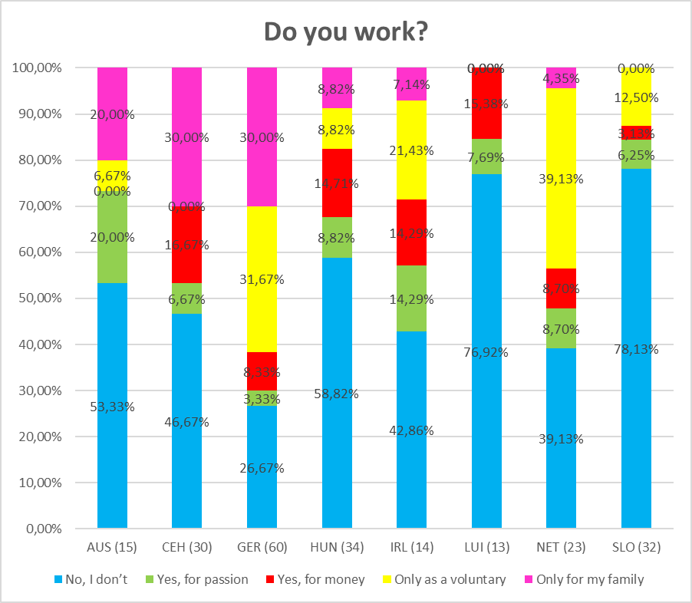
Juniors for Seniors – active ageing

Slide 22
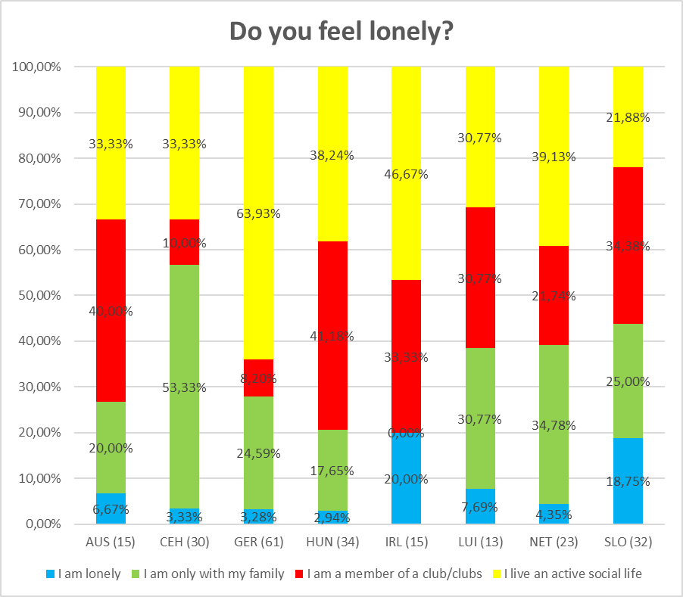
Juniors for Seniors – active ageing

Slide 23
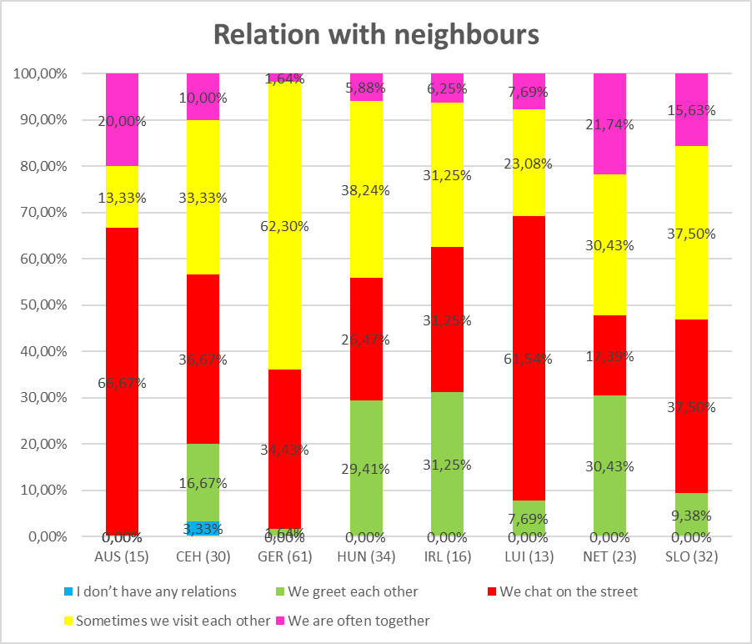
Juniors for Seniors – active ageing

Slide 24
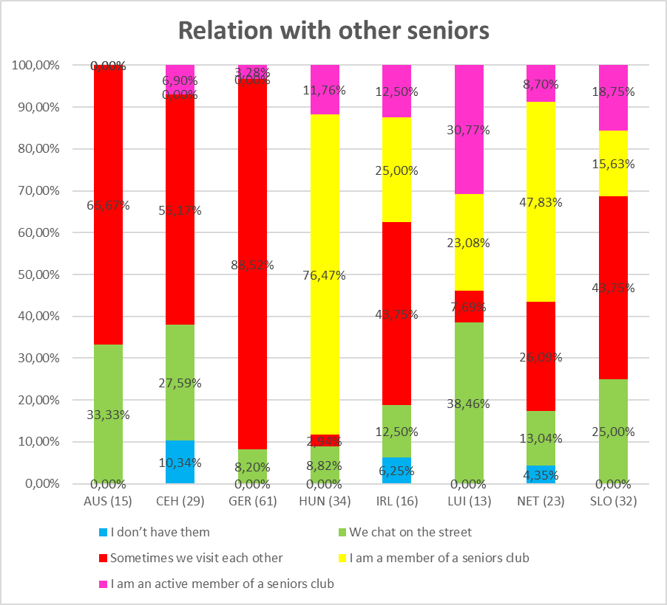
Juniors for Seniors – active ageing

Slide 25
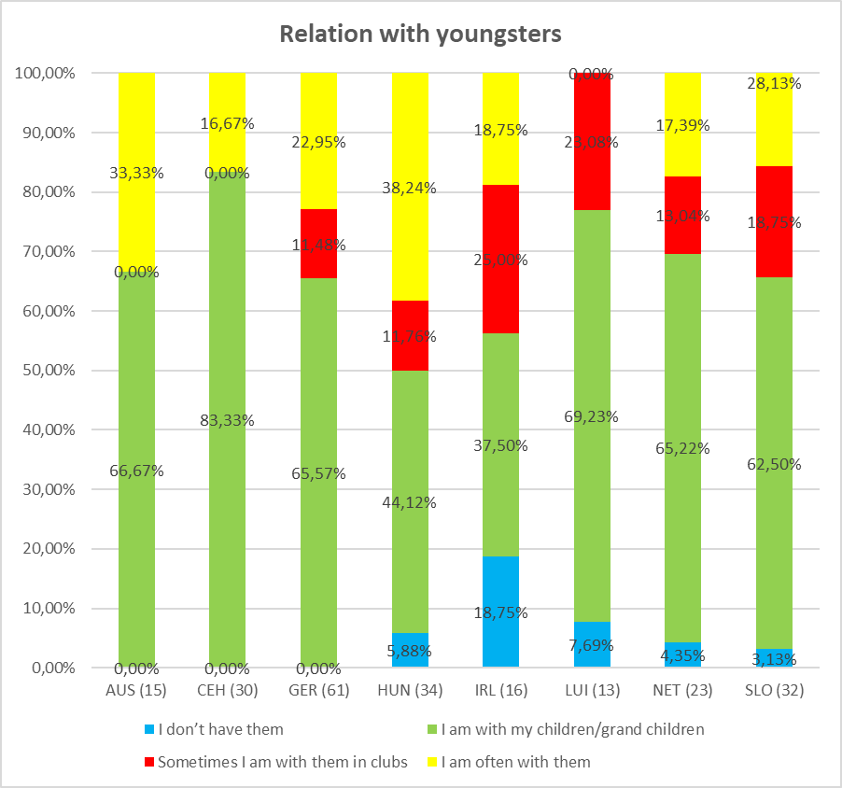
Juniors for Seniors – active ageing

