Slide 1



JUNIORS for SENIORS
ACTIVE AGING
Example:
The quality of aging
Program of Škofja Loka mag. Miha Ješe,
Municipality of Škofja Loka
Škofja Loka, Slovenia, September 2020

Slide 2
THE OBJECTIVE OF THE PROGRAMME
High-quality maintenance of the age of all citizens

Slide 3
CHALLENGES
Overview of the situation
Measures of institutional facilities
Measures of municipalities and volunteers
Support measures

Slide 4
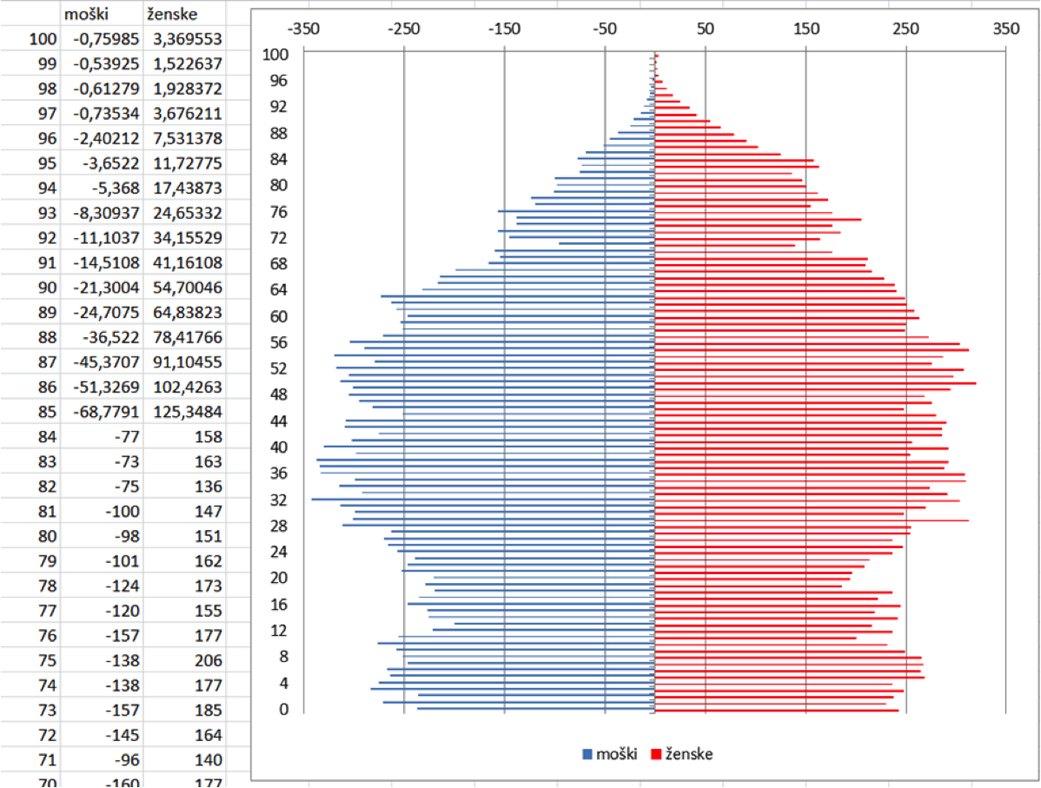
Population pyramid of the municipality of Škofja Loka,
State of 1.1.2017

Slide 5
Growth in the number of elderly people over 65 years in the municipality of Škofja Loka

Slide 6
STRENGHTS
Diverse and experienced providers: public – institutional, civil, business
The diversity of existing programmes for various target groups of the elderly
Reach and diverse cultural and recreational offer
Good attendance in existing programs
A broad base of volunteers
Retrieved intergenerational cooperation
Maintain and upgrade quality

Slide 7
WEAKNESSES
The overlap of programs
Queues for the installation in a home for the elderly, day care and help at home
Certain groups of the elderly are not included in the common life
There is no dial-up services for older people
Missing spaces for activities for the elderly
Inadequate access to the medical centre
There is no organized service offerings to assist in the maintenance of the House, shopping ..
It is not suitable flats for elderly
Avoid and develop

Slide 8
OPPORTUNITIES
The interest of the attendants for participation
Coordination of services and information in one place
Digital services at a distance and communication
Organisation of the intergenerational Center - daily meeting point
Entrepreneurial opportunities in support of the elderly
Solidarity and a transfer of knowledge between generations
Employment program for the more active older people
The construction of the (protected) flats for the elderly and the development of the common flats for elderly
To encourage and develop

Slide 9
THREATS
(Not) getting qualified staff for assisted living and nursing, including volunteers
Increase in the number of people with dementia – the unwillingness of the neighbourhood
Low pensions - increasing poverty among the elderly
Social exclusion of the elderly segment
Ensuring the affordability of services for the elderly
The provision of financial resources
Reduce and adjust

Slide 10
TOPICS 1. Olderly are active part of the local ambient.
2025 80% of the elderly are involved in various activities, in particular encourage men and those who are not activ.
2. The elderly are included in the digital society.
70% of the older people are capable to use the internet in everydays life.
Škofja Loka is test area for digital services for older people.
3. Accessible are a variety of public and private services provided to support the elderly
Solution in the shortest time possible: accommodation, assistance with care, health care, transport
4. Intergenerational (co)work and (co) live.
Increasing the number of volunteers. + 5% per year

Slide 11
Basic measures
1. Information, advice and motivation
2. Intergenerational cooperation
3. Culture, social and human contacts
4. Recreation and healthy lifestyle
5. Lifelong education and digital literacy
6. The work of older people and volunteering
7. Social care/assisted living and social service
8. Institutional care

Slide 12
1. Information, counseling, motivation
A common State and local Web portal: e-info point for seniors
Advisory-Coordination Office for the elderly
Offer the premises of the municipality or parts of them for the activity of the elderly
The municipal calls for non - governmental organizations
Already knowledge to be able to go somewhere, is sometimes enough to replace physical attendance

Slide 13
Only through cooperation we achieve
2. Intergenerational cooperation
Intergenerational assotiations Center
The aim of the substantive and two-way cooperation between the generations and various institutions (public and non-governmental)
Only through cooperation we’ll achieve our goals

Slide 14
3. Culture, social and human contacts
Support self-help
The aim of targeting less active older people in various cultural and social activities
Support for people with dementia
We can't live from the fridge, policies, invoices, and crossword puzzles
Antoine de Saint Exupery

Slide 15
4. Recreation and healthy lifestyle
New programmes adapted to the exercise for the elderly
Extension of existing workout programs
Sports areas for the elderly
Support to organize - community gardens for elderly
Give each day a chance to be the most beautiful day in your life
Mark Twain

Slide 16
5. Lifelong education and digital literacy
Content coordination between providers
New programs and approaches to the education of the elderly
Training for volunteers in order to support the elderly
Exchange of good practices
We're never too old to not being able to learn something new

Slide 17
6. Employment of older people and volunteering
Occasional and partial employment of the elderly
The program of preparation of an active retirement
The older volunteers
Promoting volunteering among all generations
You're getting, when you give to the others

Slide 18
7. Services for the care of the elderly at home
The expansion of assistance at home
Social service care
Visits of the volunteers
A friend is one soul in two bodies Aristotel

Slide 19
8. Institutional care for the elderly
Increase the capacity of the installation of the elderly house, the accent in the Department for dementia
Widening the scope of daily and temporary care
Advanced age to survive as close to home

Slide 20
Support measures
1. Health care for the elderly (the state)
2. Services for the elderly
Judenburg, March 2021
3. Residence (flats for the elderly, sheltered housing, etc.)
Škofja Loka, May 2021
4. Digital literacy
Koszeg, August 2021

Slide 21
1. Health care and prevention
Affordable highly recommended home health service
Promote the use of health care services at a distance
Ensure a sufficient capacity of the programmes for the elderly
Prevention for seniors
Healthy has thousands of desire, the ill one just one

Slide 22
2. New forms of residence in the local area
The construction of rental housing
Increase the supply of suitable small flats
The establishment of the housing community
Promoting the migration of older people from excessive housing and residential houses in small rented flats at a suitable location
Holiday homes for the international exchange of the elderly
Home sweet home, we take care that everyone has

Slide 23
3. Digital literacy
Older for older - University for 3 age
Young for the elderly
Voluntary associations
Formal educational institutions
The local community
The national authorities
Everyone has the right for computer literacy

Slide 24
4. Transport services for the elderly
Safe footpaths, cycle routes and the Elimination of barriers
Branched urban passenger transport
Development of various forms of transport
Accessibility strategy
We take care for safe routes without barriers

Slide 25
New challenges
The creation of a centralised information service for the elderly
Organisation of the programmes for the elderly with special needs
To carry out the program the municipalities should get ferom the State financing on the level in accordance with the law

Slide 26
Final conclusions and report
Bad Kotzting, October 2021

Slide 27
LONG TIME ACTIVE
LONG TIME USEFUL
FOR A LONG TIME TO HELP ALL GENERATIONS
LONG TIME HAPPY
The best possible measures for the elderly we shall developed, with greater satisfaction they'll benefit us later
.

Slide 28
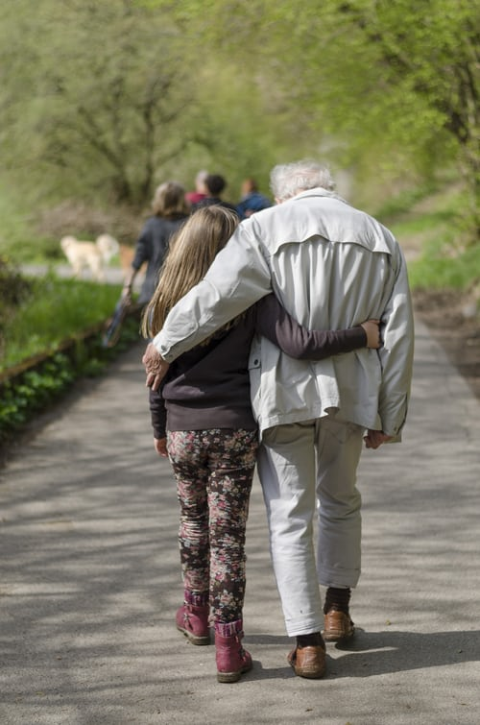
GREEN LOKA, SMART CITY
THANK YOU FOR YOUR ATTENTION

